Slide 1
Student Houses and Doctoral Student Houses
Wroclaw University of Science and Technology

Slide 2
What should I bring to the Student House ?
- bedding linen, duvet, pillow;
- kitchenware (dishes, pots, cutlery);

Slide 3
Who to contact ?
Dormitory Manager
Dormitory Reception (T15, T17,T19,T22)
Center for National and International Relations
Dział Pomocy Socjalnej dla Studentów i Doktorantów

Slide 4
Remember to:
read and follow Rules and Regulations of Dormitories at Wroclaw University of Science and Technology
it is not possible to change the dormitory and room after checking in
sign your individual contract
pay fee for a place in a dormitory till 15th of each month (we kindly ask you to initiate the transfer 2-3 days in advance, to ensure that it is credited to our PWr account by the 15th of the month. In the event of delay in the payment of accommodation, interest charges will be applied)
the monthly fee for a place in a double room is 750 PLN + utilities for the previous month.
you are required to maintain cleanliness in your room and in the common areas on a regular basis
sort and regulary dispose of the garbage in the designated area outside the buliding
treat the surroundings and neighbors with respect, and respect the quiet hours
from 11 p.m to 7 a.m
keep your personal belongings in your room (e.g shoes, clothes, dryers, garbage)
remember to always lock your room or module door when you are leaving

Slide 5
Payment of the deposit is required at check-in through the payment terminal.

Slide 6
Remember that:
smoking cigarettes, e-cigarettes and vaping inside the dormitory is forbidden,
- penalty for covering gas detectors is 400 zł
do not leave anything on the stove unattended as it may trigger the gas detectors and an alarm
– a fine of 1300 zł will be imposed for an unjustified call to the firebrigade
if you would like to invite a guest to stay overnight in your room, you must notify the dormitory administration 2–3 days in advance. The cost of the overnight stay is 30 zł per night per person.
An overnight stay of an unregistered guest will cost 200 zł.
please make sure to have a LAN cable
please check your student email account at the address below (https://di.pwr.edu.pl/uslugi/poczta/poczta-studencka)
there are no individual storage spaces in the dormitory, so when you move out, you must take all your belongings with you

Slide 7
Registration of Temporary residence :
- in Poland, there is an obligation to register a temporary residence.
- to register temporarely, you should go to the City Hall with the required application form, which you will receive from the dormitory administration
- this obligation applies to everyone, not just students staying at dormitories

Slide 8
All students planning to stay in Student Houses are required to read and follow rules at the address below.
(documents available at website https://prs.pwr.edu.pl/ https://drugidom.pwr.edu.pl/ )

Slide 9
Remember to apply for dormitory for the next academic year via USOS system!
Detailed information will be published at website
https://dps.pwr.edu.pl/

Slide 10
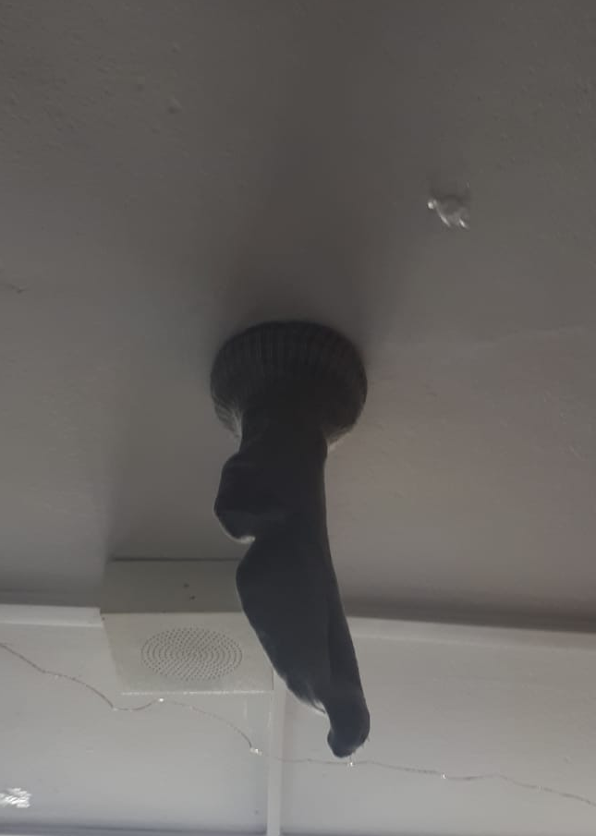
During accommodation, remember not to do
as shown in the picture.
(Otherwise, you may be
charged a fine of 400 zł from your deposit)

Slide 11
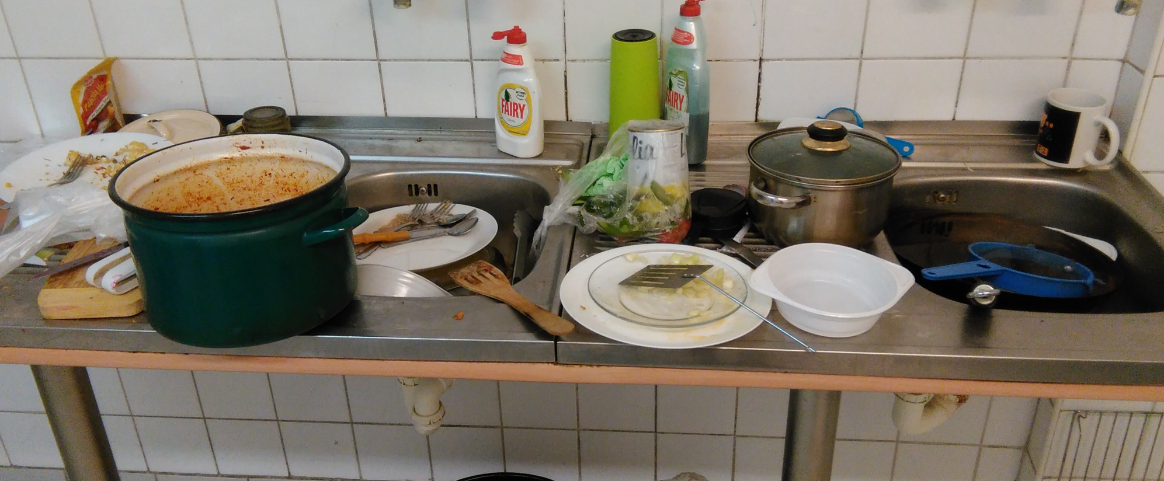
Any dirty kitchenware left behind as shown in the picture below, will be disposed of !!!

Slide 12
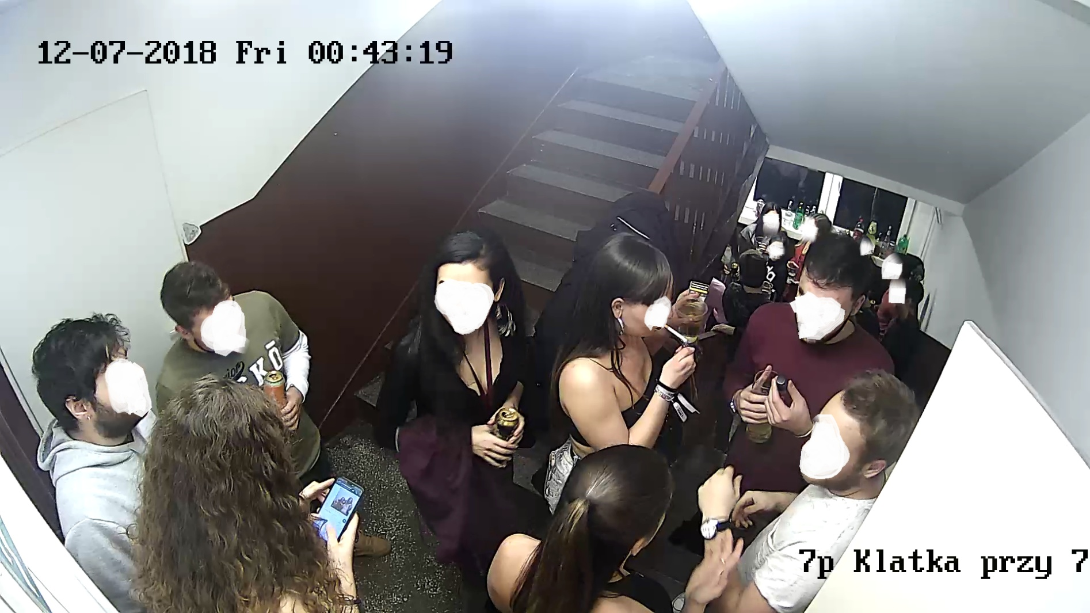
The situation shown in the picture below is unacceptable. Do not do this if you do not want to lose your place in the dormitory.

Slide 13
Thank you for your attention

Slide 14
Important websites:
https://web.usos.pwr.edu.pl/
https://prs.pwr.edu.pl/
https://dps.pwr.edu.pl/

