Slide 1
Erasmus+ 2025/2026
information session
Wrocław, January 24, 2025

Slide 2
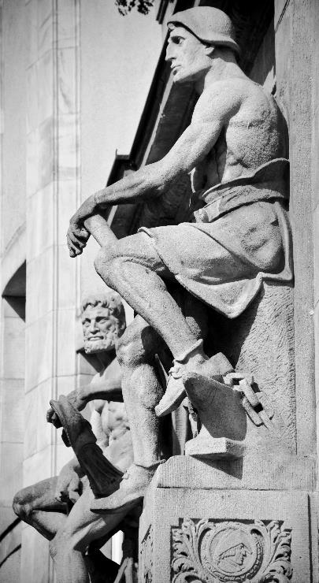
QUIZ
In which year did the Erasmus programme start?
*please do not use mobile phone

Slide 3
Few words about Erasmus
EuRopean Community Action Scheme for the Mobility of University Students
The Erasmus programme was established in 1987 as an exchange programme for university students. In the first year, approximately 3,200 students from 11 European countries took part: Belgium, Denmark, Germany, Greece, France, Ireland, Italy, the Netherlands, Portugal, Spain and UK. Today Erasmus+ offers many opportunities in higher education, vocational education and training, general and adult education, and in the fields of youth and sport. In Poland since 1998
Previous names of the Programme:
1987-1993 – Erasmus
1994-1999 – Socrates I (Socrates/Erasmus)
2000-2006 – Socrates II (Socrates/Erasmus)
2007-2013 – The Lifelong Learning Programme (LLP-Erasmus)
since 2014 - Erasmus+

Slide 4
COUNTRIES PARTICIPATING IN THE PROGRAMME
EU Members (Austria, Belgium, Bulgaria, Croatia, Cyprus, Czechia, Denmark, Estonia, Finland, France, Greece, Spain, Netherlands, Ireland, Lithuania, Luxembourg, Latvia, Malta, Germany, Portugal, Romania, Slovakia, Slovenia, Sweden, Hungary, Italy)
Third countries associated with the Program: Iceland, Liechtenstein, Norway, Turkey, North Macedonia, Serbia.
Region 13 countries: Andorra, Monaco, San Marino, Vatican City; Region 14 countries: Switzerland, United Kingdom, Faroe Islands;
Third countries not associated with the Program (e.g., Kosovo, Bosnia and Herzegovina, Albania).

Slide 5
MOBILITY OPPORTUNITIES
Long-term mobilities for studies at a partner university abroad (from 2 to 12 months)
Traineeship in a company/university/research institute abroad (from 2 to 12 months)
Short-term mobilities (from 5 to 30 days) for students and PhD students to the Unite! Network
Grenoble INP UGA (France)
ULisboa (Portugal)
KTH (Sweden)
Aalto University (Finland)
TU Darmstadt (Germany)
TU Graz (Austria)
Politecnico di Torino (Italy)
Barcelona Tech (Spain)
Wrocław Tech (Poland)
Graduate traineeships abroad (recruitment in the final year of study, completion within 12 months from the date of the thesis defence or submission of doctoral thesis).
BIP (Blended Intensive Programme)

Slide 6
POSSIBILITIES OF MULTIPLE MOBILITIES
The total duration of all mobilities may not exceed 12 months within a single cycle of studies (mobility capital)
NOTE: mobility capital also includes Erasmus+ zero-grant mobility
Previous mobilities under LLP-Erasmus, Erasmus+ (KA103 i KA107) oraz Erasmus Mundus are also calculated into the mobility capital
NOTE: for long-term mobility it is possible to study at only one university during one academic year

Slide 7
GENERAL CONDITIONS
Every WrocławTech student and PhD student can participate in the programme
The candidate’s country of origin and citizenship do not matter in the recruitment process
At the time of departure, you must have completed at least the first year of undergraduate studies, which means you can take a part in the recruitment process during the first year, so after completing it you can start your mobility

Slide 8
WHO CAN GO?
Students of I (after completing 1st year) II of full-time and part-time studies, PhD students; the offer does not apply to students of postgraduates studies
NOTE: a student applying for a mobility in the first semester of the second degree must have the status of a second degree student at the time of the start of the exchange and a signed agreement on the provision of educational services with the home university
A student studying in two or more fields may apply for mobility from only one field in which the above conditions are met
NOTE: Departure for studies/traineeship may not interfere with the completion of studies, within the period foreseen in the study plan – mobility during any type of leave eg. dean’s leaves, sick leaves, etc. are not possible

Slide 9
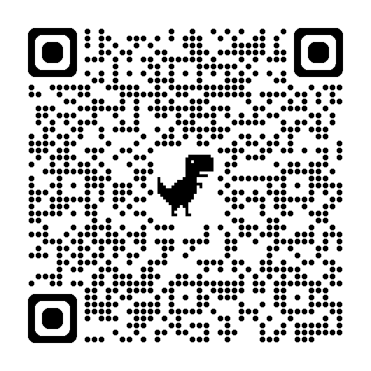
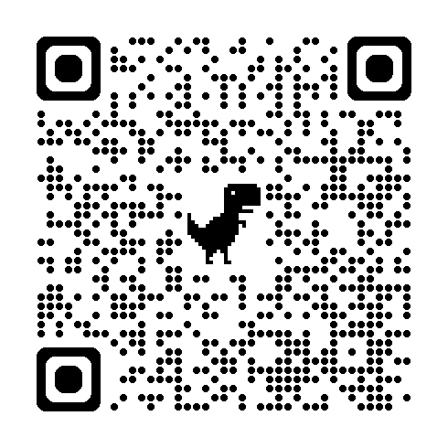
STUDIES MOBILITIES - SMS
Detailed Recruitment Rules for 2025/2026 are available on the website:
List of partner universities is available on the website:
Recognition of the period of study abroad without the need to repeat the year or take a dean’s leave
The scholarship holder does not lose the status of student of Wrocław University of Science and Technology (they retain a right to receive financial assistance and other benefits, except for a place in a dormitory)
Students pay tuition fees for their studies at WrocławTech also during their stay at the partner university

Slide 10
RECRUITMENT PROCEDURE
1 STAGE
1. Choosing a partner university and checking a deadline for submitting nominations and applications (from the list of available universities on the website)
NOTE: Scandinavian and Dutch universities usually have very early deadlines for nominating candidates
2.Contact with the Faculty Coordinator
Recruitment takes place at the Faculties. Candidates are assessed on the basis of:
average grade (base on the certificate from the Dean’s Office)
foreign language proficiency at the B2 level at least
additional criteria indicated by the Faculty Coordinator
NOTE: Faculties may, under the General Rules of the Programme, apply individual criteria for the recruitment of students
End of recruitment March 12, 2025

Slide 11
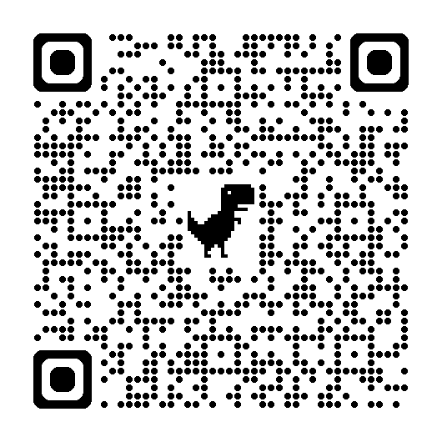
RECRUITMENT PROCEDURE
Foreign language proficiency
Language exam
Level B2 - applies to students who do not have appreciate language certificates or did not take language classes at the University (a printout from Education approved by the Dean’s Office)
March 12, 2025 (details provided on the website of the Department of Foreign Languages - SJO)
Students with certificates Wydziałowych
Need to deliver the copy of the language of the certificate to the Faculty Coordinators
The list of the recognized certificates can be found on the SJO
IMPORTANT! You cannot assume that every university participating in the Erasmus+ program offers courses in English for every field of study. When planning to study abroad, for example in Spain, without knowledge of the local language, you should check the university's website to see if courses in your field are offered in English.

Slide 12
RECRUITMENT SCHEDULE
March 12, 2025 – end of recruitment of candidates at the faculties. The Coordinators will submit to IRO lists of students who will require to take a language exam
March 15, 2025 - language exams for candidates
March 18, 2025 - preparation of preliminary lists of candidates for mobilities at the faculties, including reserve lists
March 23, 2025 - information meeting for pre-qualified students*
April 30, 2025 – deadline for submission of application forms in the IRC system (whole academic year and a winter semester)
November 30, 2025 – deadline for submission of application forms in the IRC system (whole academic year and a winter semester)
NOTE: The original documents must be submitted to CRM on the day of signing the financial agreement (no earlier than 3 weeks before the planned departure).
*the date will be confirmed
Wydziałowych

Slide 13
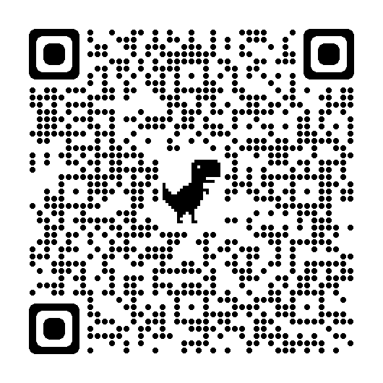
WHERE TO APPLY?
STAGE: choice of partner university, contacting Faculty Coordinators
Submit the documents required by the Coordinators
The names and addresses of the Coordinators can be found at:
End of enrollment of students at Faculties by March 12, 2025
STAGE: Information meeting for pre-qualified students March 23, 2025*
*the date will be confirmed

Slide 14
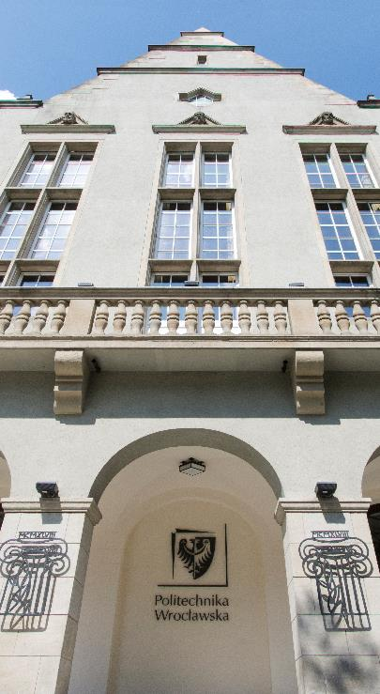
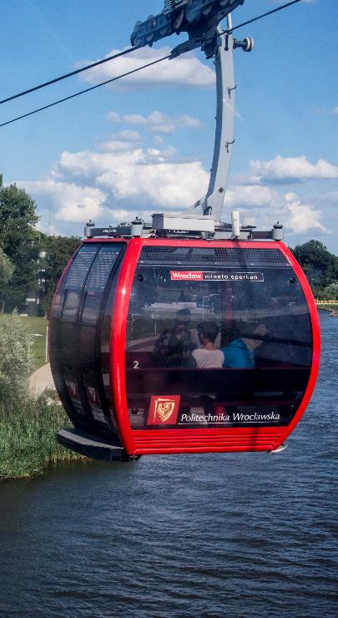
SCHOLARSHIP
The Erasmus+ scholarship is a form of financial support for studies abroad and does not cover the full cost of stay
Monthly rates are constant and depend on the country of departure
The funding period depends on the total funding granted to the University in the given academic year
Payment in 2 instalments - the first one before departure (80% of the grant); second instalment (till 20% of the grant) after return and and submitting the financial documents
The stay at the host institution must take place between:
July 1, 2025 and September 30, 2026

Slide 15
Amount of funding (studies)* Study mobilities: from 2 to 12 months
Countries in the group | Monthly scholarship rate in EURO
Group 1 – Austria, Belgium, Denmark, Finland, France, Germany, Ireland, Island, Italy, Lichtenstein, Luxmeburg, Netherlands, Norway, Sweden region 13 and 14* | EUR 670
Group 2 – Cyprus, Czech Republic, Estonia, Greece, Spain, Latvia, Malta, Portugal, Slovakia, Slovenia | EUR 670
Group 3 – Bulgaria, Croatia, Hungary, Lithuania, North Macedonia, Romania, Serbia, Turkey | EUR 600
14 - UK, Switzerland, Faroe Islands
13 - Andorra, Monaco, San Marino, Vatican

Slide 16
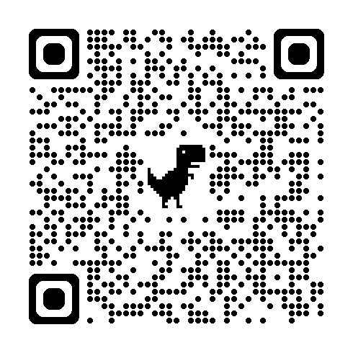
Other funding opportunities
Additional scholarship from the Wrocław City Council – information available on the Wrocław Academic Center website.
Funding for students with disabilities of EUR 250 per month – in the case of higher demand, an additional application must be submitted at least one month before the start of mobility. The costs incurred must be confirmed with financial documents (invoices, bills, tickets etc.)
Additional funding of EUR 250 for each month of mobility for students entitled to a social scholarship at WrocławTech (on the basis of certificate/copy of decision)

Slide 17
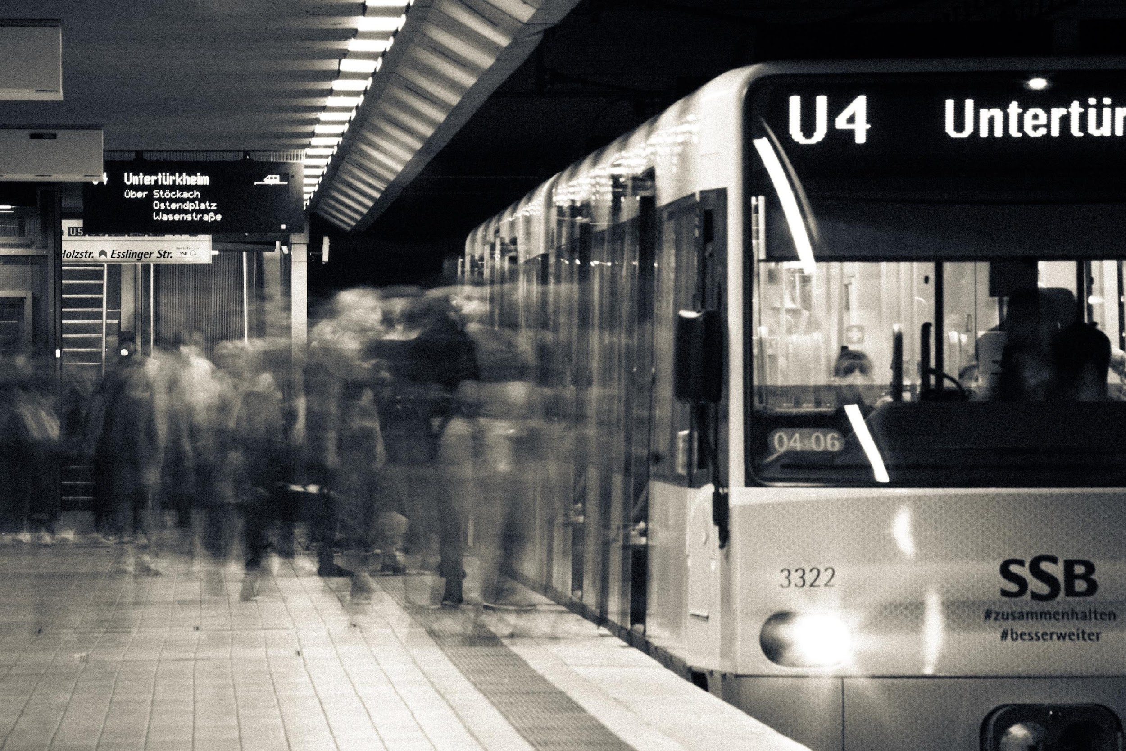
„Green Travel”
Travel using low-emission means of transport such as buses, trains, or carpooling.
Traveling only one way using low-emission means of transport is not sufficient for the journey to be recognized as “green travel” and to receive an increased travel grant.
The introduction of a requirement/recommendation to use low-emission means of transport for distances up to 499 km.
IMPORTANT: Travel days cannot overlap with the exchange period.

Slide 18
Blended Intensive Programmes - BIP
Blended Intensive Programmes – short-term exchange- classes at the partner university (min. 5 days) with a virtual component – min. 3 ECTS,
5-14 days – EUR 79 €/day,*
15-30 days – EUR 56/day*
recruitment for BIPs take a place at Faculties
“Student with fewer opportunities”
5-14 days - 100 EUR/mobility
15-30 days- 150 EUR /mobility
Travel may be co-financed in the form of a lump sum based on the Erasmus+ calculator
distances (for students with fewer opportunities)
*rate may change

Slide 19
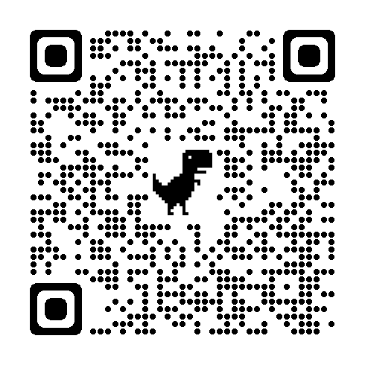
Traineeship mobilities - SMT
Organized in companies, research centres and universities
Student traineeship – from 2 to 12 months;
Recent graduate traineeships:
Recruitment during studies - implemented within 12 months from the date of thesis defence or submission of doctoral thesis
Graduates have the possibility of multiple mobilities during the year from thesis defence or submission of doctoral thesis and within the framework of their own mobility capital.

Slide 20
Benefits of the Erasmus+ programme
Opportunity to study abroad with Erasmus + financial suport
Better chances of finding job within a year of graduation
Gaining soft skills highly valued by future employers
Gaining new, valuable international experience
Possibility of polishing a foreign language in a natural environment
Opportunity to get a new culture and visit interesting places
Establishing international friendships
Gain international and intercultural competencies, as well as cultural awareness

Slide 21
What does the programme offer?
The opportunity to gain a professional experience abroad
Traineeship consistent with the field of study
Obtaining funding of the traineeship

Slide 22
Amount of funding (traineeships)* Traineeship mobilities: from 2 to 12 months
Countries in the group | Monthly scholarship rate in EURO
Group 1 – Austria, Belgium, Denmark, Finland, France, Germany, Ireland, Island, Italy, Lichtenstein, Luxmeburg, Netherlands, Norway, Sweden region 13 and 14* | EUR 820
Group 2 – Cyprus, Czech Republic, Estonia, Greece, Spain, Latvia, Malta, Portugal, Slovakia, Slovenia | EUR 820
Group 3 – Bulgaria, Croatia, Hungary, Lithuania, North Macedonia, Romania, Serbia, Turkey | EUR 750
14 - UK, Switzerland, Faroe Islands
13 - Andorra, Monaco, San Marino, Vatican

Slide 23
Other funding opportunities
Funding for trainee with disabilities of EUR 250 per month – in the case of higher demand, an additional application must be submitted at least one month before the start of mobility. The costs incurred must be confirmed with financial documents (invoices, bills, tickets etc.)
Additional funding of EUR 250 for each month of mobility for students/graduates entitled to a social scholarship at WrocławTech (on the basis of certificate/copy of decision).

Slide 24
Financial support
The scholarship is co-financing of costs related to travel and stay abroad. It is intended to cover partial costs of the travel, accommodation subsistence and other expenses related to the traineeship
The host institution may offer:
“pocket money”
accommodation
food
travel refunds
The specific financial conditions are regulated by the agreement on the implementation of the traineeship.

Slide 25
Erasmus traineeship - required documents:
signed application form;
a certificate from the Dean’s office with a weighted average of all grades obtained during the course of studies
confirmation of foreign language proficiency:
- a copy of a language certificate with a hard-copy for inspection, or
- a copy of the page from grade book with a grade from the exam at the minimum level of B2/ B2.2.
the opportunity to take the exam organized by CRM March 15, 2025 (registration: klaudia.krzyszkowska@pwr.edu.pl till March 7, 2025)

Slide 26
Award of the grant
Recruitment is ongoing - the only deadline concerns graduates who need to submit their application documents before the thesis defence/submission of doctoral thesis.
Application will be considered on an ongoing basis and grants will be awarded until the funds are exhausted.
The grant will be awarded after submitting the acceptance by the host institution.
The maximum number of students qualified for the Programme depends on the amount of funding granted in a given year by the National Agency of the Erasmus+ Programme.

Slide 27
How to find a traineeship?
check the information on the website of the International Relations Office – traineeship offers are published in the news
use personal contacts (international trips, Erasmus+ studies)
visit the websites of large companies and international concerns e.g. Philips, Siemens
ask for help from lecturers/promoters
ask family and friends

Slide 28
What matters when you’re looking for a traineeship?
time - do not put off looking for a company
carefully prepared documents (CV and cover letter)
direct contact with the company (arrangements regarding traineeship plan, traineeship period, possible additional salary)
Patience
thoughtful selection of companies (write only where you really want to go)

Slide 29
IMPORTANT
Compulsory online language test (OLS) before departure
No possibility of combining funding from several EU programmes
You are responsible for completing all required formalities
Qualification for the Programme is not a guarantee of going abroad for studies/traineeship
The financial condition for participation in the Programme is acceptance of the traineeship application by the host institution

Slide 30
Tuition fees at the Wrocław Tech and Erasmus+
Participating in the Erasmus+ studies or traineeships does not exempt students from paying the fees for their studies at WrocławTech, except for the graduate internship, which takes place after graduation
The payment of the Erasmus+ grant only be made after the payment of the tuition fee for the year in which the mobility will take place
There is no tuition fee for studying at a host University within the Erasmus+ Programme

Slide 31
QUIZ 2
What is the maximum duration of the mobility capital for each study cycle ?
*please do not use mobile phone

Slide 32
QUIZ 3
What means of travel are recognized for green travel in Erasmus? Give 3 examples
*please do not use mobile phone

Slide 33
QUIZ 4
What is the first step to apply for Erasmus+ student mobility?
*please do not use mobile phone

Slide 34
Double Degree Master Program
T.I.M.E. Top International Managers in Engineering
Network of 57 leading technical universities from 24 countries, including Europe, Asia, Australia, Canada, Latin America.
Only two universities from Poland: Wrocław University of Science and Technology and AGH in Cracow.
Educational master program based on diverse cultural backgrounds, culminating in two diplomas implemented on the basis of an agreement between two partner universities.

Slide 35
Double Degree program objectives
education based on diverse cultural backgrounds under the agreements of partner universities, leading to obtaining two diplomas (from home and host universities) addressed to WUST graduates
implementation of the agreed study program and achievement of learning outcomes within the required period of the study (3 semesters at the partner university to receive the so-called TIME Label Certificate)
studying in the partner university language (or in English)
familiarity with the culture, education system and customs of another country
possibility of an internship in a foreign company
acquisition and improvement of work skills in an international group
greater employment opportunities on the international labor market

Slide 36
Wroclaw Tech partner universities in T.I.M.E. (offer only for alumni of Wroclaw Tech)
Centrale Supelec “
Centrale Mediterranee “
Centrale Nantes “
Centrale Lille “
Ecole Centrale Lyon “
Ecole des Ponts et Chaussees – ParisTech (f. of civil eng., environmental, mechanical, management, mathematics)
Politecnico di Milano (all faculties except architecture)
RWTH Aachen University (faculty of electrical eng., mechanical eng.)
LUT University, Finland (faculty of electrical eng.)

Slide 37
How to apply?
WUST student status, diploma of Bachelor of Engineering
Superior academic results, level of English (B2)
Dean’s consent to participate in the Double Degree program
Recruitment at home university by the T.I.M.E. Coordinator and the Erasmus+ Faculty Coordinator
Required documents:
Application for Erasmus+ as Double Degree candidate
Transcript of records
Learning Agreement (agreed study plan)
Individual Study Program approved by the Dean
Student’s nomination issued by the home university
Letter of motivation (activity in research clubs, volunteering, participation in exchange program is a plus)
* scholarship is offered in the Erasmus+ and you should apply for it in the same intake

Slide 38
Agreements of Double Degree at WUST
Universite de Limoges, France (Faculty of Mechanical Engineering)*
Ryerson University, Canada (Faculty of Electrical Engineering)*
BTU Cottbus, Germany (Faculty of Electrical Engineering)*
Otto-Von-Guericke Universitat, Germany (Faculty of Electrical Engineering)*
University of Palermo, Italy (Faculty of Electrical Engineering)*
TU Bergakademie Freiberg, Germany (Fculty of Geoengineering, Mining and Geology)*
University of Miscolc, Hungary (Faculty of Geoengineering, Mining and Geology)*
* detailed information about the programmes at Faculty Coordinators

Slide 39
Students interested by Double Degree programs should contact me directly at:
International Relations Office
Ewa Mroczek – Double Degree T.I.M.E. Program Coordinator
ewa.mroczek@pwr.edu.pl

Slide 40
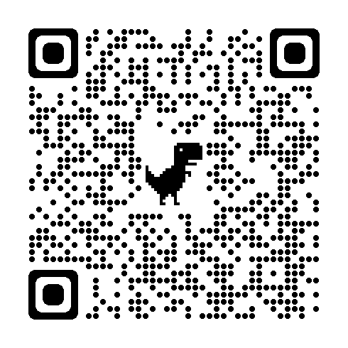
STUDENT EXCHANGE PROGRAMME
The Student Exchange program offers students the opportunity to study for one or two semesters to one of the partner universities with which the university has signed a student exchange agreement (agreement other than Erasmus+). Students cover all costs related to travel and stay at the host university on their own, unless some scholarship has been granted from home university.
Where can you go?
Brazil, China, India, Indonesia, Israel, Japan, Canada, Kazakhstan, South Korea, Mexico, Thailand, Taiwan, Ukraine and Vietnam
Exchange duration: semester or entire academic year*
possibility to shorten/extend your stay during the exchange
Students of: the second year of first-cycle studies, a first-year student of second-cycle studies, or a first-year doctoral student
Important!!! Active student status, you cannot be on dean's leave!
Exchange without payment of a scholarship but: the possibility of applying for a scholarship from a given host university or a scholarship from the government of a given country; NAWA scholarship
Student Scholarship Program - Wrocław Academic Center

Slide 41
HOW TO APPLY?
If you are interested, please complete the Application Form available on the CRM website in the Student Exchange tab. Please choose up to two destinations.
But first:
- check the deadline for nominations of partner universities;
- check the courses offered by partner universities;
Documents required by CRM - submitted in the IRC system after acceptance by the host university
Application form;
Learning Agreement/Individual Study Plan - signed by the Faculty Coordinator/Dean of the Doctoral School
Transcript of Records;
Knowledge of English at least B2 level (according to CEFR) or a grade from a foreign language course from Department of Foreign Languages
Certificate of student status (in English, certified by the dean's office)
Certificate of weighted average GPA from the dean's office for the current degree of studies
Dean's permit (before departure)
Insurance certificate for the trip
If you need to change to LA (Changes to LA) during your stay

Slide 42
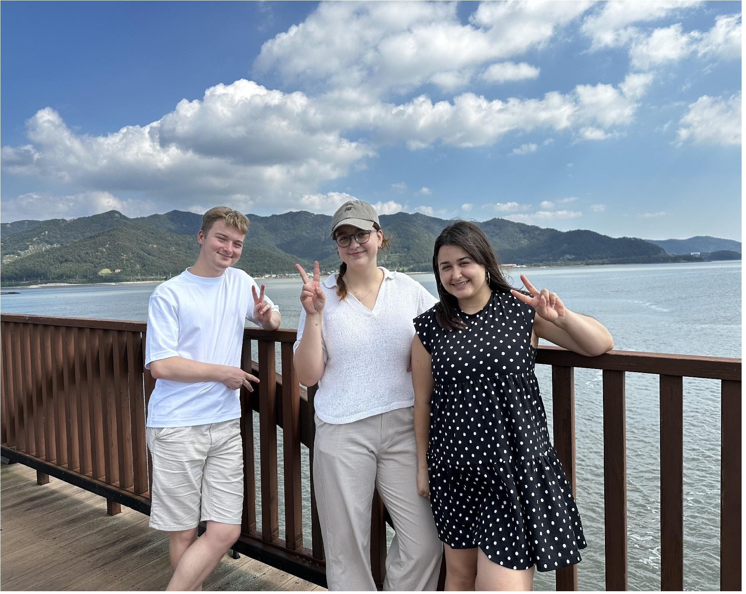
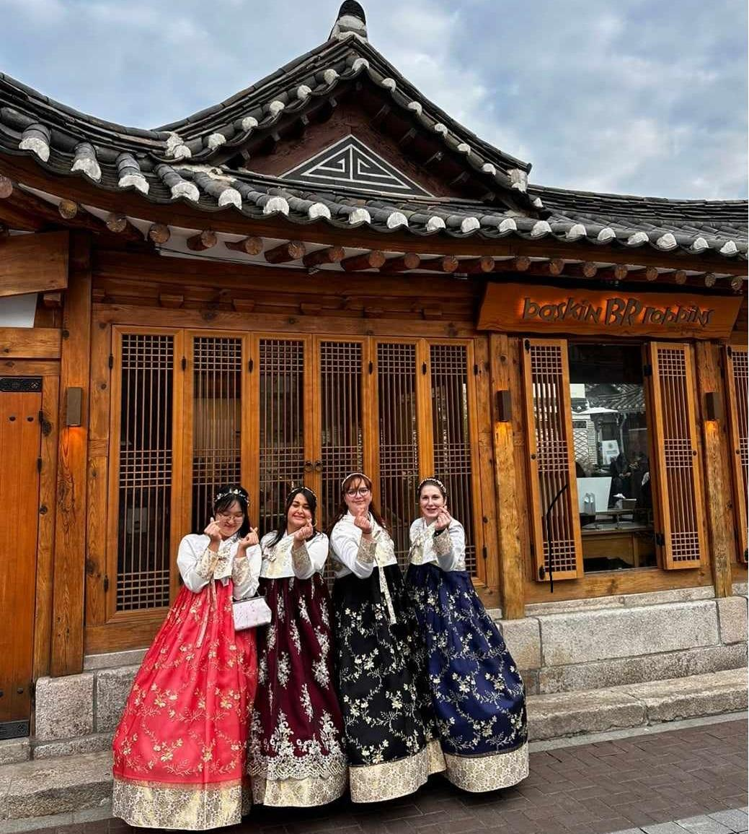
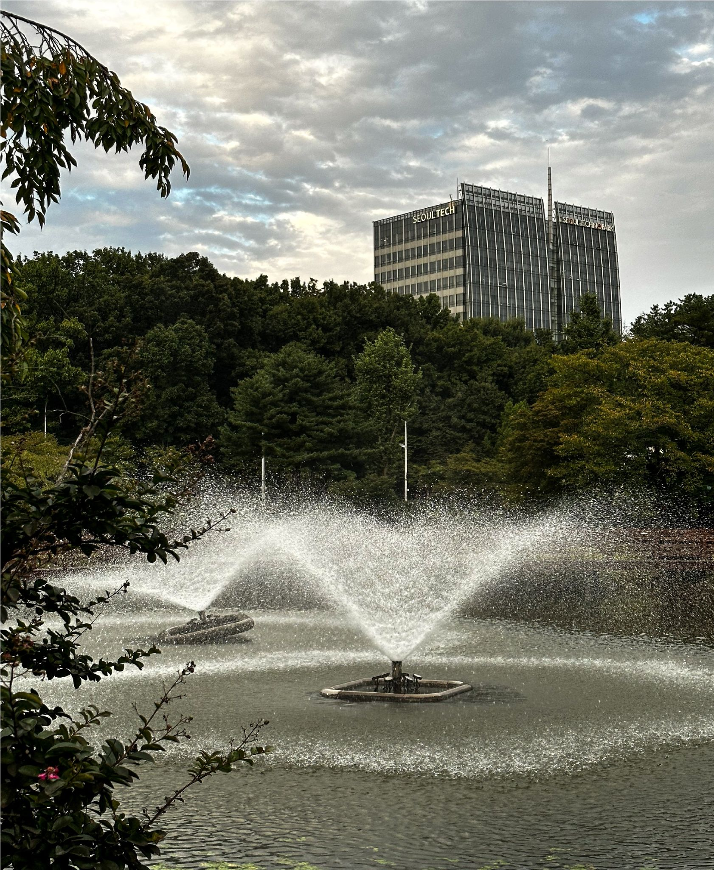
SEOULTECH WINTER 2023/24
cross-cultural experience
added value for future employee
diverse network and cultural immersion

Slide 43
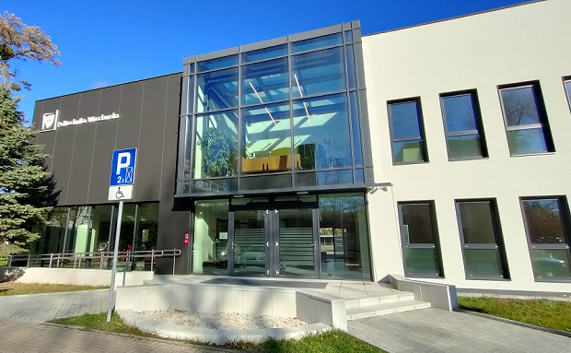
Center for International Relations
12 Na Grobli Street
Building L-3, 1st floor
Wroclaw, 50-412
ERASMUS+ INSTITUTIONAL COORDINATOR
Julia Bohdziewicz, MSc
e-mail: julia.bohdziewicz@pwr.edu.pl
phone: 71 320 41 21
STUDIES Joanna Latuszek, M.A. (W1-W6)
e-mail: joanna.latuszek@pwr.edu.pl
phone: 71 320 25 43
Klaudia Krzyszkowska, B.A. (W7-W14) e-mail: klaudia.krzyszkowska@pwr.edu.pl
phone: 71 320 78 92
INTERNSHIPS, TRAINEESHIPS M.A. Krystyna Komorowska e-mail: krystyna.komorowska@pwr.edu.pl phone no: 71 320 46 72
BIP M.A. Katarzyna Małańczuke
e-mail: katarzyna.malanczuk@pwr.edu.pl phone: 71 320 78 92
EXCHANGE STUDENT
PROGRAMME COORDINATOR
Barbara Jarosz, Eng.
e-mail: barbara.jarosz@pwr.edu.pl
phone: 71 320 45 68
TIME COORDINATOR
Ewa Mroczek, M.A.
e-mail: ewa.mroczek@pwr.edu.pl
phone: 71 320 41 63

Slide 44
Thank you for your attention!

Slide 45
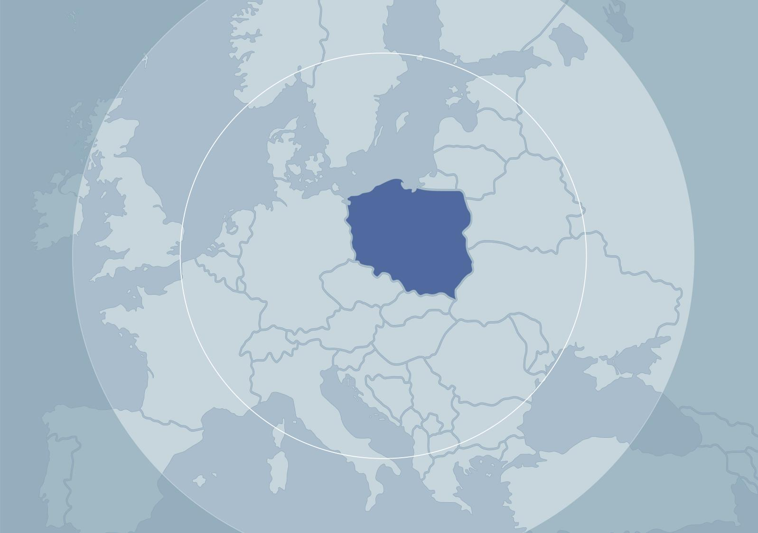
Stockholm
Copenhagen
Poland
London
Amsterdam
Berlin
WROCŁAW
Brussels
Paris
Prague
Kiev
Vienna
Budapest
Rome

