Slide 1
WELCOME TO THE WUST LIBRARIES

Slide 2
All WUST students are welcome to our campus libraries. Here you can find a wide selection
of books, as well as digital resources such
e-books, e-journals, databases, and other online materials.
We also offer you trainings, individual study rooms and exhibitions.
Our friendly staff are here for you - both digitally and physically.

Slide 3
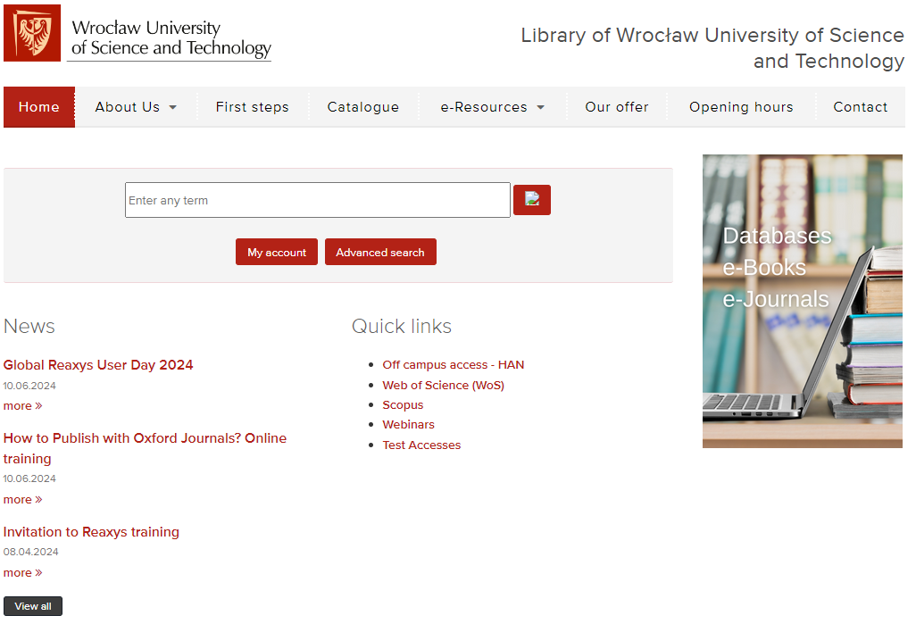
OUR WEBSITE
https://biblioteka.pwr.edu.pl/en/

Slide 4
OUR LIBRARIES
LOCATIONS

Slide 5
Main Circulation Desk and Reading Room
A-1, rooms 307/307A
Fiction Circulation Desk and Reading Room
A-1, room 308
Map of WUST libraries
Branch libraries
at faculties
Interlibrary Loan
D-21, room 003
Open Study Zone
D-21
Scientific Information
D-21, rooms: 101, 104, 108, 226, 227
Standardization
D-21, room 002

Slide 6
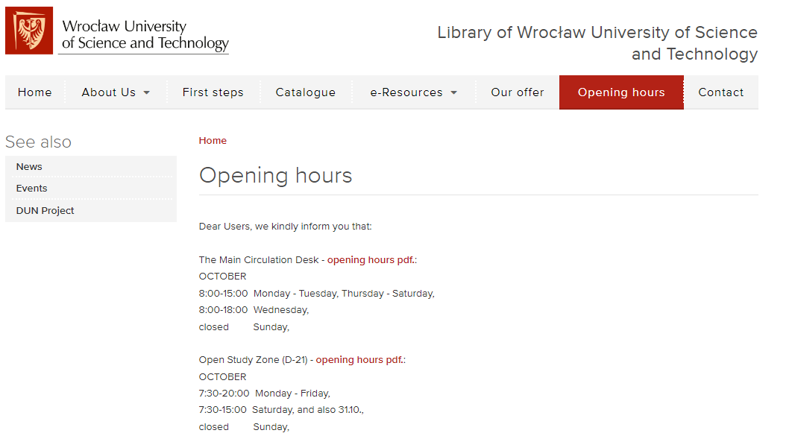
Opening hours
You can find the opening hours as well as the locations and contact details of the WUST libraries on our website.
https://biblioteka.pwr.edu.pl/en/

Slide 7
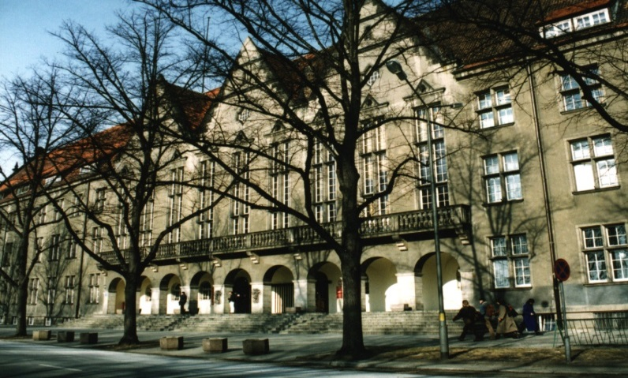
Main Circulation Desk and Reading Room
Building A-1, rooms 307/307A
Student library services:
our students can get access to many resources wherever they are working
or studying.
In Main Circulation Desk and Reading Room: printed books and journals.

Slide 8
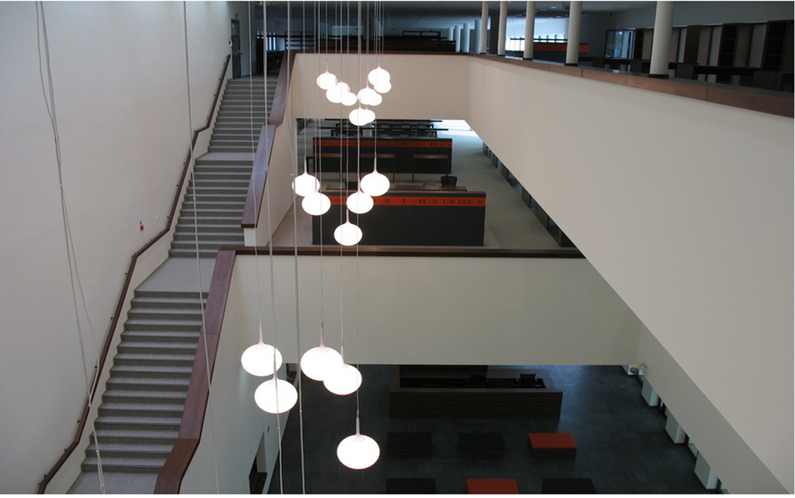
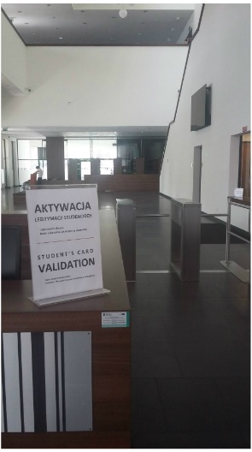
Open Study Zone
Building D-21
Security Gates in D-21:
please use your student ID and the link to register: skd.pwr.edu.pl (on site)
Use open space to study

Slide 9
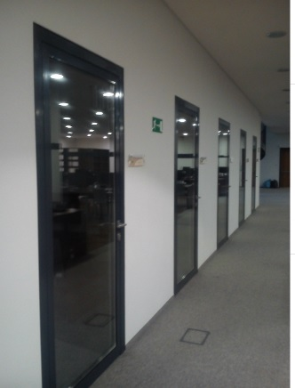
Open Study Zone
Building D-21
INDIVIDUAL STUDY ROOMS (1st and 2nd floor)
To use an Individual Study Room, you must have an active library account and book a room in our catalog.

Slide 10
USER REGISTRATION
On site and remotely

Slide 11
USER REGISTRATION
https://biblioteka.pwr.edu.pl/en/first-steps
On site
in person at the library;
bring an Electronic Student Card.
Remotely
biblioteka.wyp@pwr.edu.pl
send a scan of your Student Card and a scan of the filled and signed card application.

Slide 12
Loans
10 books in every library
10
6
3
6 months
3 days to collect

Slide 13
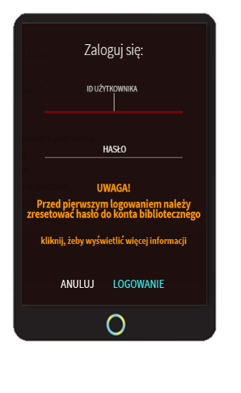
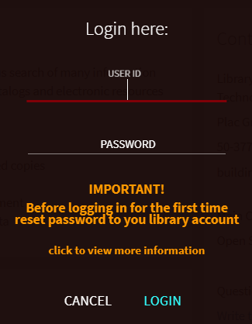
LOGIN TO PRIMO VE
USER ID:
student ID numer
Before the first logging you have to reset your password to your library account.
https://biblioteka.pwr.edu.pl/en/
Catalogue
Sign in

Slide 14
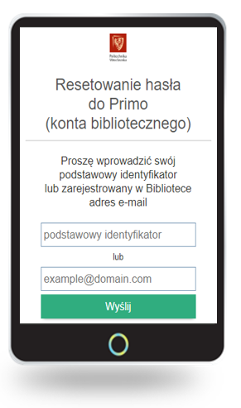
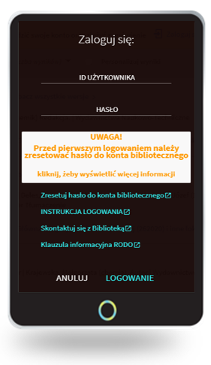
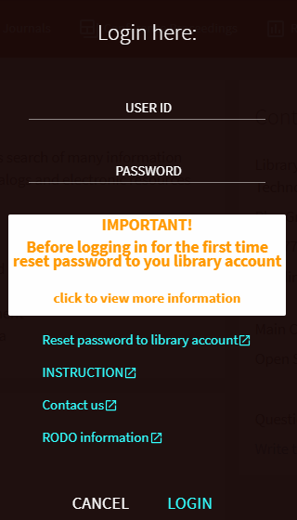

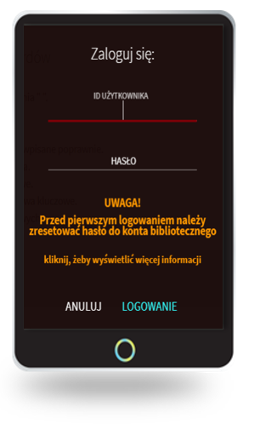
https://biblioteka.pwr.edu.pl/en/
Catalogue
Sign in
3
2
Choose reset password to library account. Enter your student ID numer in the first box.
You will receive an e-mail with a link to reset your password.
1
Reset your password

Slide 15
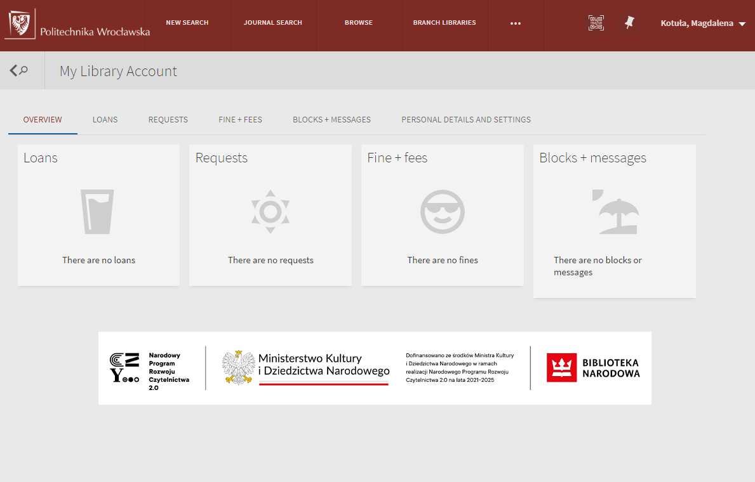
About Primo
Primo provides simple and simultaneous search of many information resources, incl. the content of library catalogs and electronic resources available in the Library.
Primo offers the following possibilities:
localization and ordering of printed copies;
requesting a scan of the materials available in the library;
booking individual study rooms;
library account management;
linking to the full text of the document;
saving and exporting collected data.

Slide 16
Order and collect your books
Log in and search for a book
Place an order
Collect your book
where (in which library) books are available;
books available on site and for loan;
order through the catalog (Primo);
order by email or phone*;
books from open access collections*;
* only in selected libraries
pick up the book at the library indicated in the order;

Slide 17
e-Resources
databases, e-Books, e-Journals

Slide 18
e-Resources
https://biblioteka.pwr.edu.pl/en/e-resources
HAN - off campus access
WUST network
Access to electronic resources for registered users.
Access to digital versions of textbooks from the collections of the WUST Library (selected terminals in the Open Study Zone in building D-21).
Supports most paid full-text services (e-books and e-journals) and databases.
Open access
Resources available to everyone.

Slide 19
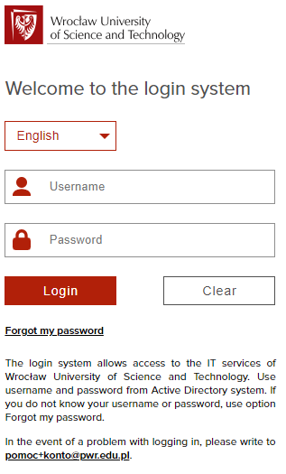
e-Resources
HAN - off campus access
To log in to electronic resources remotely via HAN, the following data should be used:
login Active Directory (without @pwr.edu.pl / @student.pwr.edu.pl)
invidual password in AD system.
If you have problems accessing
e-resources via the HAN system, please contact us: han@pwr.edu.pl

Slide 20
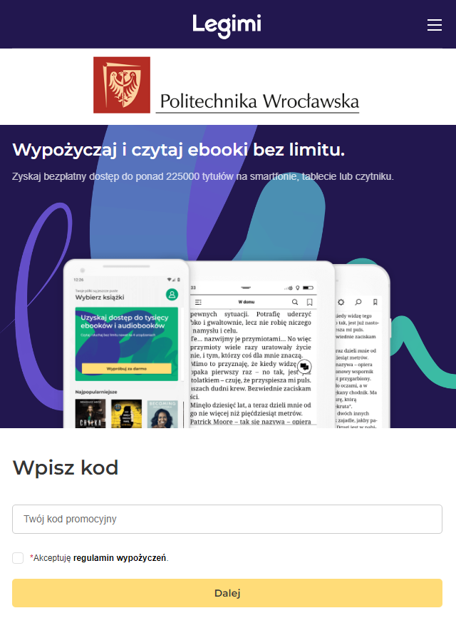
FICTION
LEGIMI
over 25 000 fiction e-books and audiobooks (mainly
in Polish)
to receive legimi code you must be registered
at the University Library
Fiction Library (building A-1, room 308)
only Polish literature
Branch library of the Department of Foreign Languages (building H-4, room 514)

Slide 21
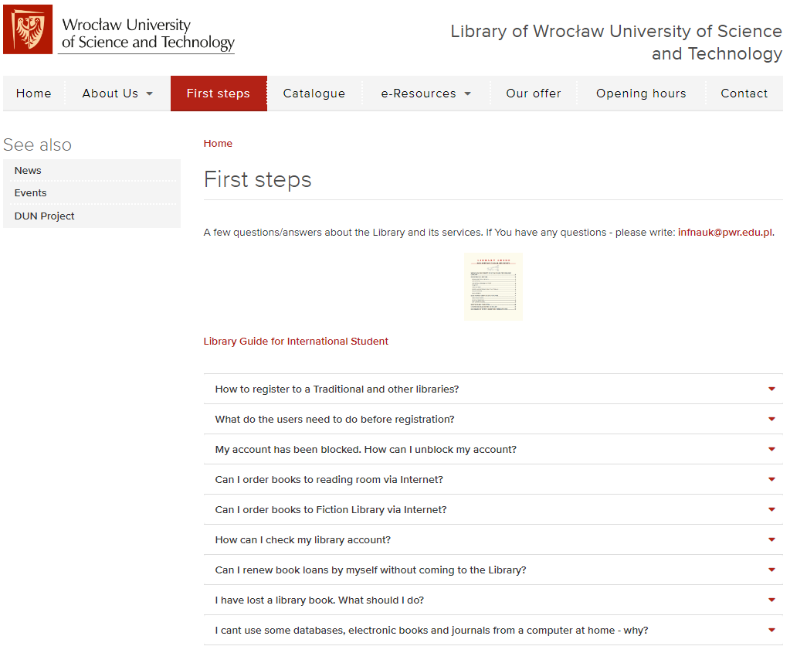
DETAILED GUIDE HOW TO USE THE LIBRARY
https://biblioteka.pwr.edu.pl/en/first-steps

Slide 22
INDIVIDUAL WORKSHOPS AND TRAININGS
How to locate the library resources efficiently and effectively
How to find a relevant database, e-journals, e-books or other resources
How to connect off campus
Need help? Please send an email
infnauk@pwr.edu.pl

Slide 23
USEFUL CONTACTS
Problems with authentification and Active Directory
pomoc+ad@pwr.edu.pl
Problems with your library account
biblioteka.wyp@pwr.edu.pl
Problems with remote access to e-resources
han@pwr.edu.pl

Slide 24
IF YOU HAVE MORE QUESTIONS
Library of Wrocław University
of Science and Technology
Building D-21, room 104
jolanta.wrobel@pwr.edu.pl

Slide 25
Thank you for your attention
Prepared by Magdalena Kotuła, Monika Ziemek
Graphics and design: Pixaby.com | GoogleSlidesppt.com

