Slide 1
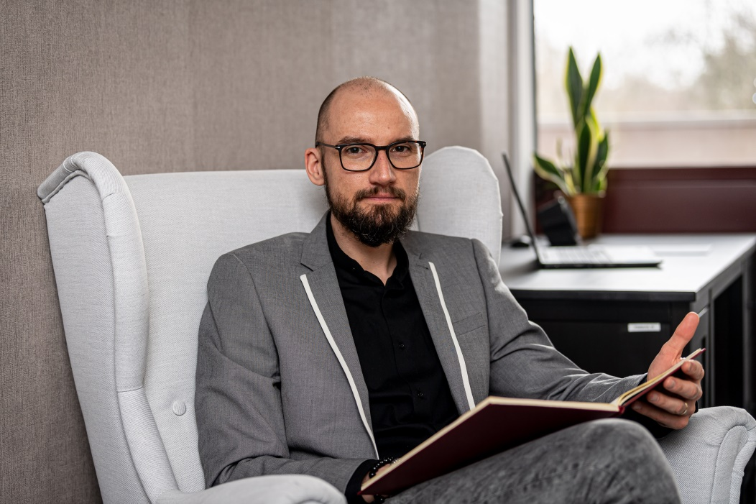
Who I am ?
mgr Mateusz Kur, psychologist, culture anthropologist
I represents
Center for Psychological Consultation and Mediation

Slide 2
We offer psychological support and help to students in:
Handling problems with adaptation into a new environment (Wroclaw, university, dormitory)
Finding solutions in conflicts in relationships (with other students and staff)
Giving professional advice on how to attain personal goals
Coping with mental difficulties caused by exams or tests
Overcoming anxiety and fear
Handling problems with low self-esteem, lack of motivation and mood swings
Breaking language and cultural barriers – support available in English
Helping to all people with some disabilities

Slide 3
Below are listed some areas I specialise in:
Psychological support for people in crisis
Boosting motivation, finding ways for self-improvement and setting personal goals
Counselling in the sign language for the deaf and hearing impaired
Running workshops and educational practice
Handling problems in relationships
Resolving conflicts using the NVC (Non-violent Communication) method

Slide 4
HOW TO CONACT ME ?
Mateusz Kur (psychologist)
E-mail: m.kur@tnm.org.pl
Telefon: +48 516 005 583
Centrum Wsparcia: ul. Wróblewskiego 25
Akademik T-22, parter | pok.6.1
Online chat or a phone call
Appointments booking: https://ddo.pwr.edu.pl/dla-studentow/wsparcie-psychologiczne/centrum-konsultacji-psychologicznych

Slide 5
HOW TO CONACT ME ?
Online chat or a phone call
m.kur@tnm.org.pl
Mob. +48 516 005 583
Appointment in advance is necessary!

