Slide 2
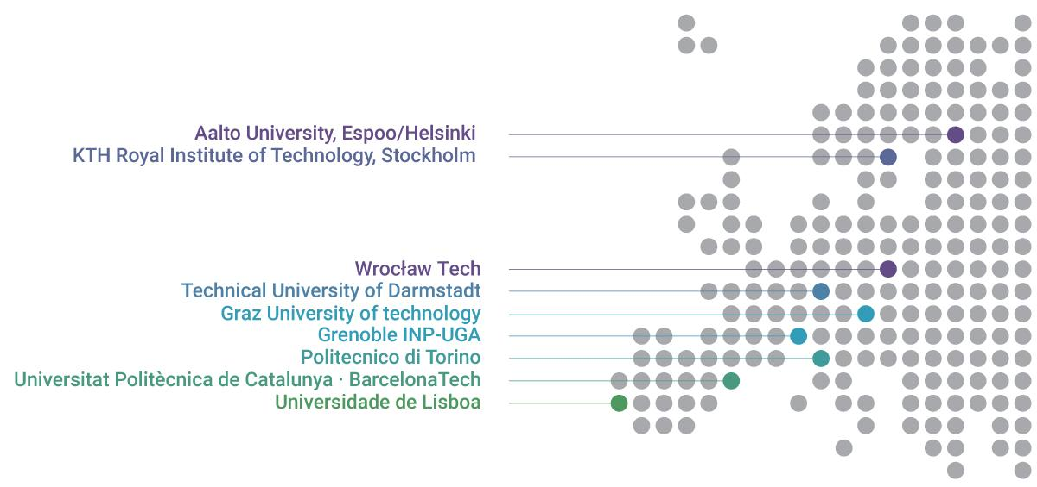
Who are we?
Unite! is a strategic, dynamic and inclusive European University Alliance of innovation, technology and engineering, based on shared values, a common vision and mutual trust.
Unite! commits to being a strong driving force for technology and innovation that will train the experts that drive the digital and green transition.

Slide 3
European Universities Initiative
The European Universities alliances are a flagship initiative of the European strategy for universities to transform the European Higher Education Area,
Alliances between higher institutions from all across Europe, for the benefit of their students, staff and society and co-created by them,
Aims to improve the international competitiveness of higher education institutions in Europe and promote European values and identity,
Implemented primarily through Erasmus+ funding,
60 alliances with more than 500 universities,
Unite! among the first round of alliances starting 2019.

Slide 4
Highlights from Unite! Mission Statement – Identity and Vision
Contributing to achieving the UN Sustainability Goals through the digital and green transition.
Unite! stands out:
As a strong driving force for technology and innovation advancing a green and digital Europe
For transformative transdisciplinarity that draws from engineering, science and the full range of multidisciplinarity of the member universities
Unite!’s ambition:
Reach excellence in education, research and innovation by creating unique new opportunities for students, academics, staff and further ecosystem partners

Slide 5
Unite! Key objectives 2030
Strategic long-term collaboration
Strong and inclusive community
Innovative
teaching and learning opportunities
Trans-European
Campus

Slide 6
Focus areas
Sustainable energy
Artificial intelligence
Industry 4.0
Entrepreneurship

Slide 7
Unite! projects with EU funding (1)
Unite! E+ (2019-2022, 2023-2026/28) Focus on building the structure of the Alliance and education, funded through Erasmus+
Unite! WIDENING (2023-2028) Focus on research, funded through Horizon WIDERA
Unite.H2020 (2021-2023) Focus on research, funded through Horizon 2020

Slide 8
Unite! projects with EU funding (2)
Unite!Energy - Unite! Doctoral Network in Energy Storage (2024-2027) A hydrogen vision for sustainable energy storage
aUPaEU – A University Partnership for Acceleration of European Universities (2023-2027) Integration and implementation of acceleration services for the institutional transformation of Higher Education Institutions
GreenChips-EDU (2023-2027) Educational initiative for urgently needed specialists for the European semiconductor industry
ED-AFFICHE – European Degree: Advancing, Facilitation and Fostering International (2023- 2024) Collaboration in Higher Education Development of recommendations on a future European Degree label
IDEM - Inclusion, Diversity, Equity in Mobility (2022-2025) Implementation of a new model of inclusive European student mobility
JPROV – Joint Programmes: Embedding Virtual Exchange (2021-2023) Creating a framework for the development of innovative and efficient Joint Programmes

Slide 9
Governance of Unite! - overview
UGP
Strategic decisions
Ensuring institutional commitment
Executive Board
Preparing strategic decision
Representing the UGP
Political lobbying (national & EU-level)
USC
Strategic discussions & operational decisions
Overall alliance coordination
Ensuring institutional implementation
Secretariat
Operational alliance governance & management
Preparing decisions for Unite! strategic & advisory bodies
Political lobbying (EU)
UAF
Strategic advice on strategic and academic topics
Evaluation of the Unite! Seed Fund
Election of Unite! president
SURE!
Student representation
Student empowerment & advising
Strategic leadership
Unite! Governing Platformprogram asana
Unite! president and Executive Board
Rectors/presidents & Vice-presidents of Unite! partners
Highest decision-making body
Efficient management
Unite Steering Committee
Unite! Secretary General
Key Liason Officers of Unite! partners
Active participation
Unite! Academic
Forum
UAF Chair
Academic, institutional
SURE!
Spokes persons
Unite! Student Forum

Slide 10
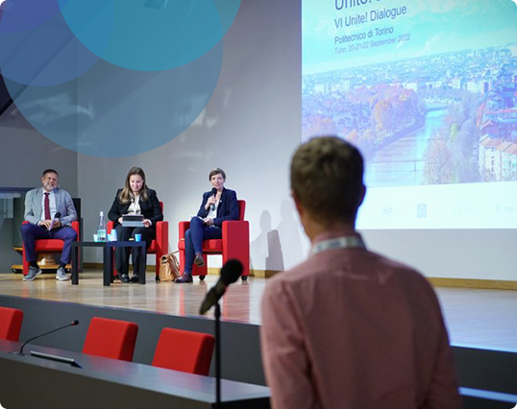
Unite! Dialogues
Main Unite! community event,
Semi-annual meetings to gather all Unite! communities and stakeholders,
Work meetings, community building, sharing of results and planning for the future,
Hosted by the alliance universities, in succession.

Slide 11
What do we work on?
Joint teaching
Joint research
and innovation
Student mobility

Slide 12
Open activities and offers
The activities and offers are constantly evolving. They are collaborative, and involve two or more Unite! universities.
Students
Virtual and blended courses
Summer and winter schools
Joint Master’s programmes
Seed fund opportunities
Teachers
Pedagogical trainings
Collaboration opportunities
Mobility opportunities
Seed fund opportunities
Researchers
Sharing of infrastructures
Matchmaking events
Seed fund opportunities
Administrative staff
Staff mobility
Networking and exchange
Seed fund opportunities

Slide 13
Anshika Suri, Unite!’s Deputy Secretary General
I believe Unite! offers unique advantages for staff and students alike. The sharing of innovative resources such as the establishment of IRIS (integrated research and innovation services), open science and research data management trainings, blended intensive programs, benefit both academic staff and students alike. The seed fund also aims to provide students with the opportunity to come up with bottom-up solutions which could be funded for their innovative design and strategies.

Slide 14
Unite! for students

Slide 15
Internationalise your studies with Unite!
Virtual and blended courses,
Summer and winter schools,
Language and culture courses,
Joint Master's Programmes,
Seed funding for collaborative student activities,
Extra-curricular activities.

Slide 16
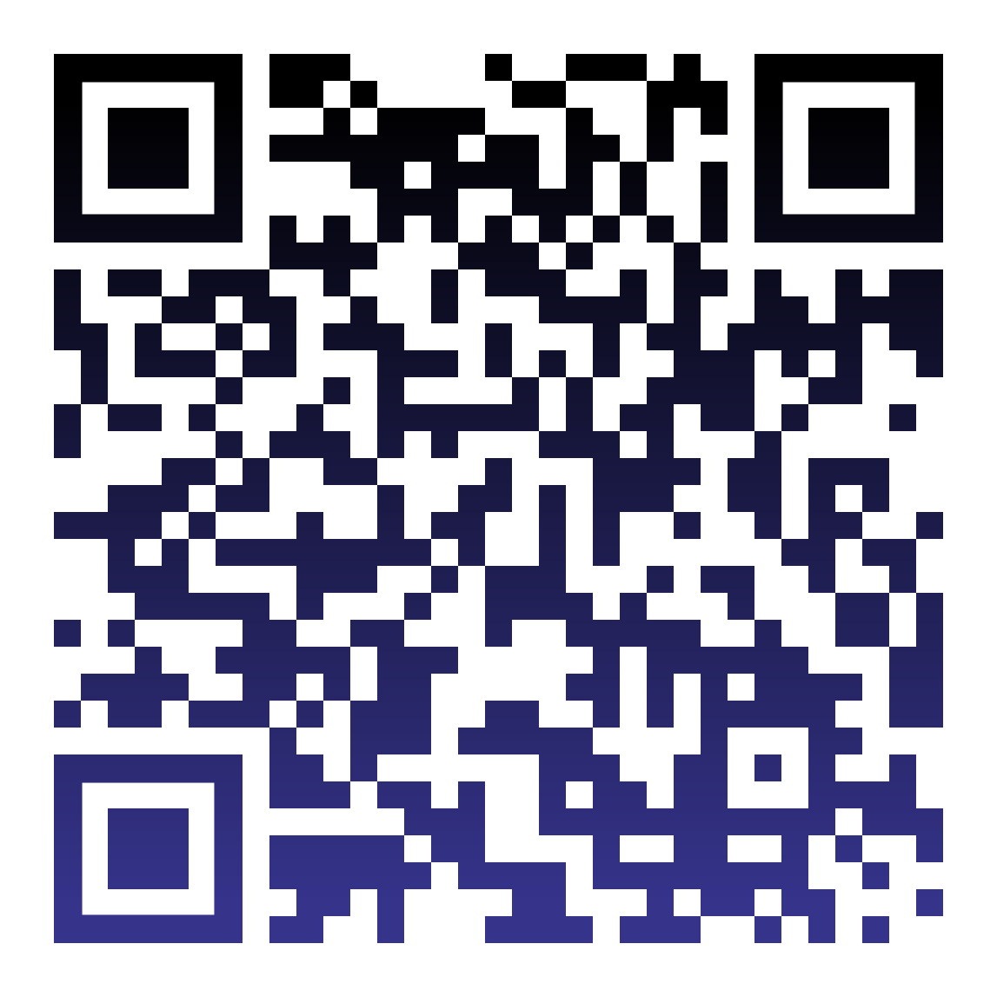
Find more offers
Visit the Unite!
Student Catalogue
Courses
Joint Master's Programmes
MOOCs
Extra-curricular activities
Attend the Unite! Student Fair
Contact the Student Liaison Officers

Slide 17
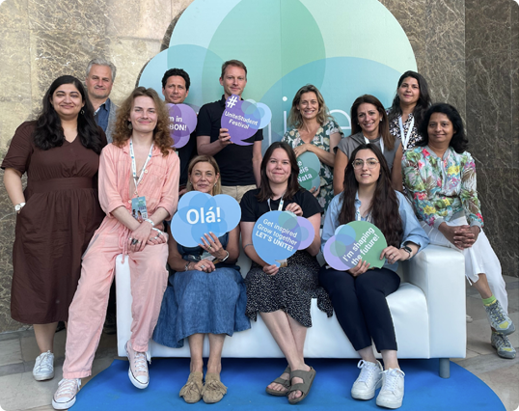
Student Liaison Officers (SLO)
SLOs connect students, promote Unite! offering, and collaborate to boost student involvement in Unite!,
Help you to find partners for the Student Activities Seed Fund from another Unite! University,
Check the Unite! website "Contact" for your uni-versity's SLO.

Slide 18
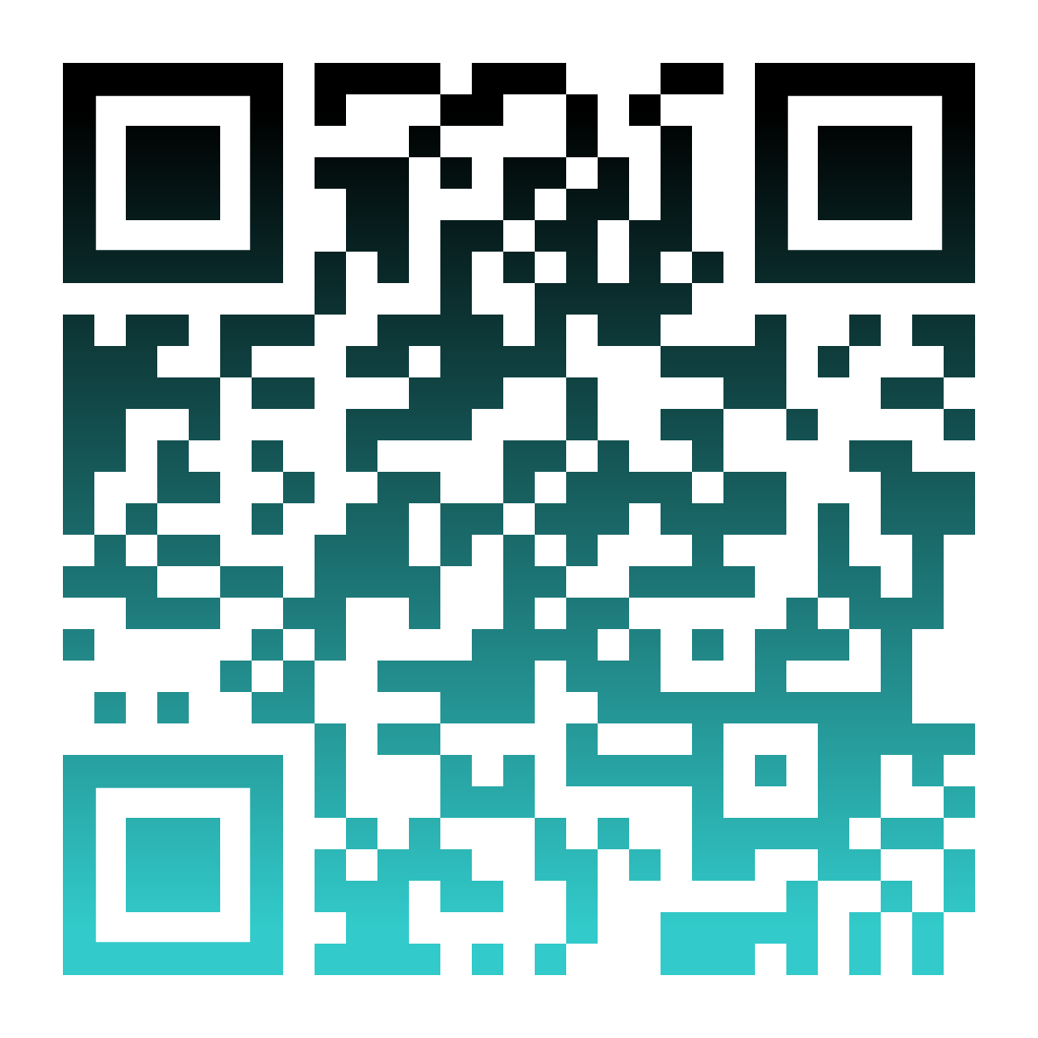
Students are an integral part of Unite!
Students are part of the decision-making bodies and working groups of Unite!,
Students have their own association SURE! – Students in Unite! for Representation and Empowerment.

Slide 19
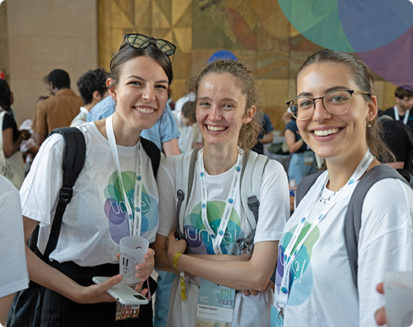
Unite! Seed Fund
For students and student associations to build collaborative projects,
Max funding 20 000 EUR,
Students from minimum two Unite! universities,
Applications open twice a year.

Slide 20
Unite! Reading Club
The first professional international inter-university reading club,
Initiated by students from three universities,
Open for all Unite! students and staff,
Received seed funding from Unite!

Slide 21
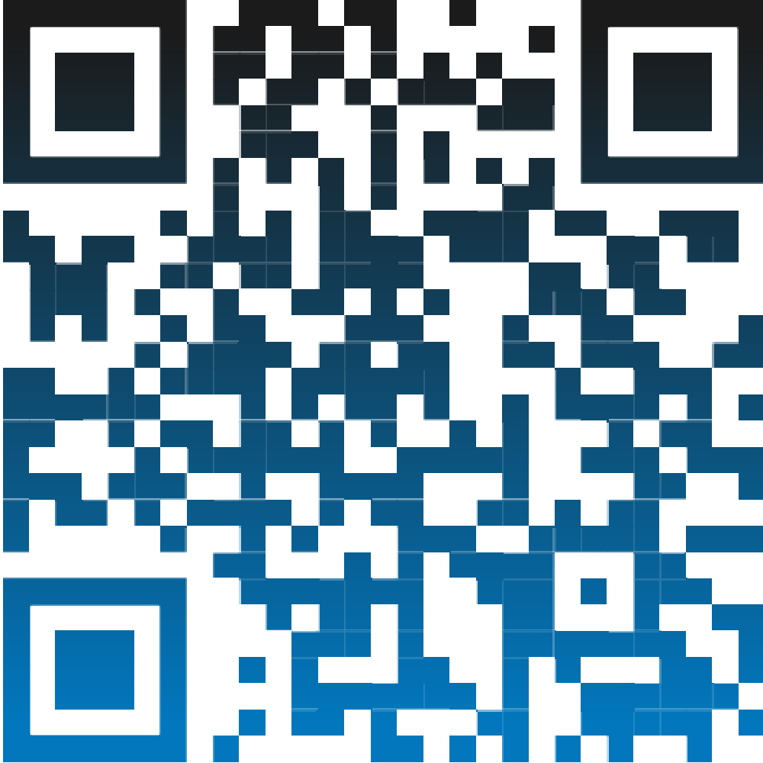
Metacampus
Is the federated digital platform for teaching and learning of the Unite! Alliance,
Is especially suitable for joint courses or trainings within Unite!,
Is a Learning Management System (LMS) based on Moodle.
Access to Unite! Metacampus:
https://metacampus.unite-university.eu/
Log in using your institution's credentials.

Slide 22
Unite! Seed Fund
For teachers to build collaborative courses and programmes,
For researchers and PhD students to build collaborative projects,
Max 10 000 Euros for establishing contacts and formulating collaboration ideas,
Max 80 000 Euros for developing joint research, courses and programmes,
At least 3 Unite! partners,
Applications open once a year.

Slide 23
www.unite-university.eu secretariat@unite-university.eu @unite_tech_univ linkedin.com/company/uniteuniversity/ instagram.com/uniteuniversity
Get involved!

