Slide 1
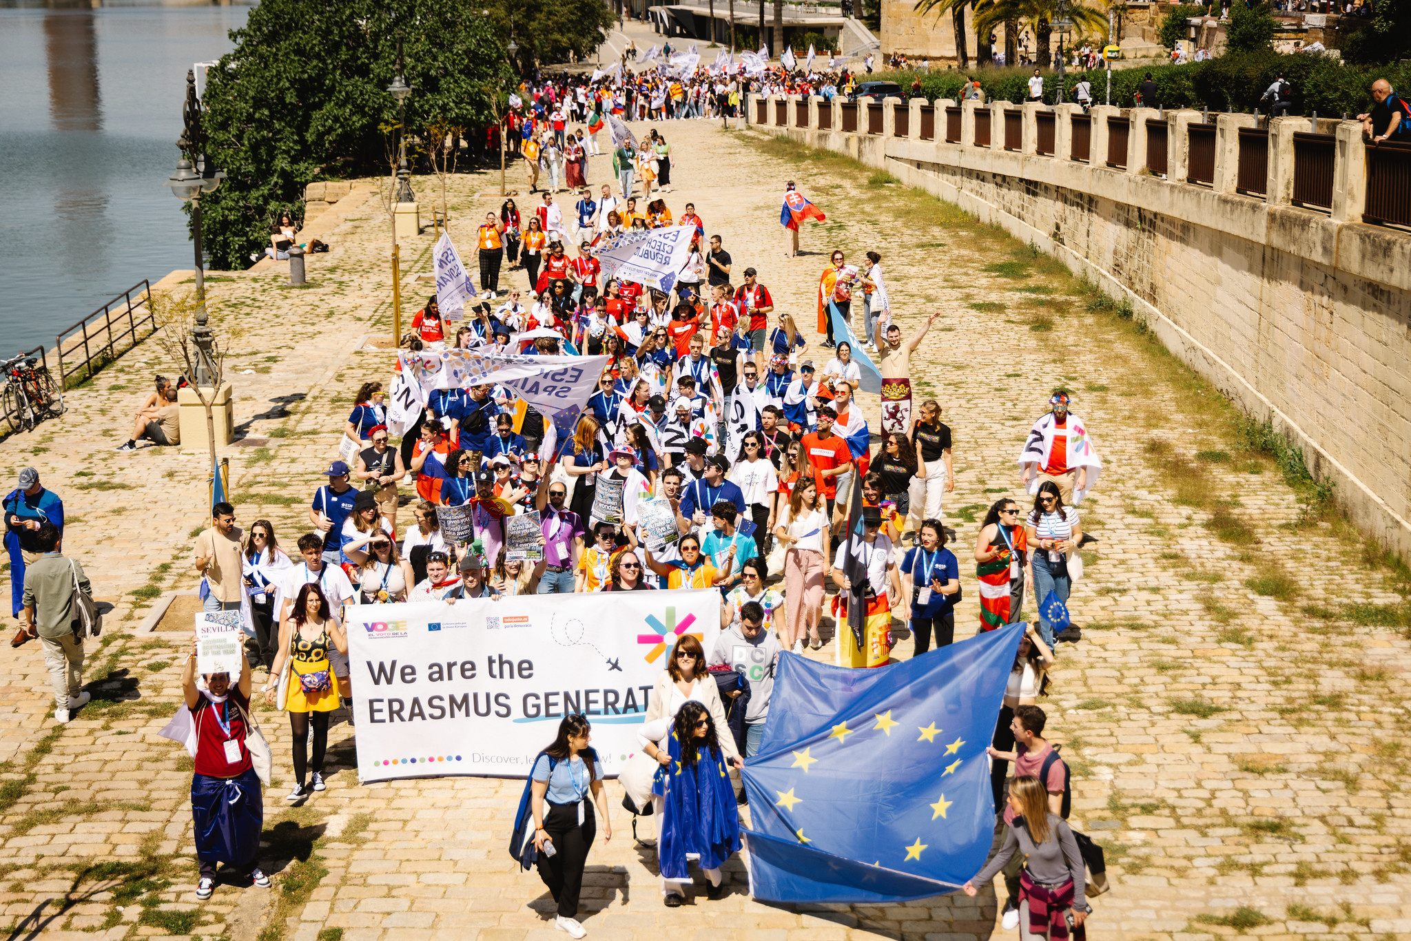

YOUR ERASMUS JOURNEY BEGINS
Notes:
ESN organises several events every year, where ESN volunteers from all over Europe meet to exchange ideas and best practices, and take decisions for the future of the organisation. This picture was taken during the Annual General Meeting in Thessaloniki, in April 2019.
‹#›

Slide 2
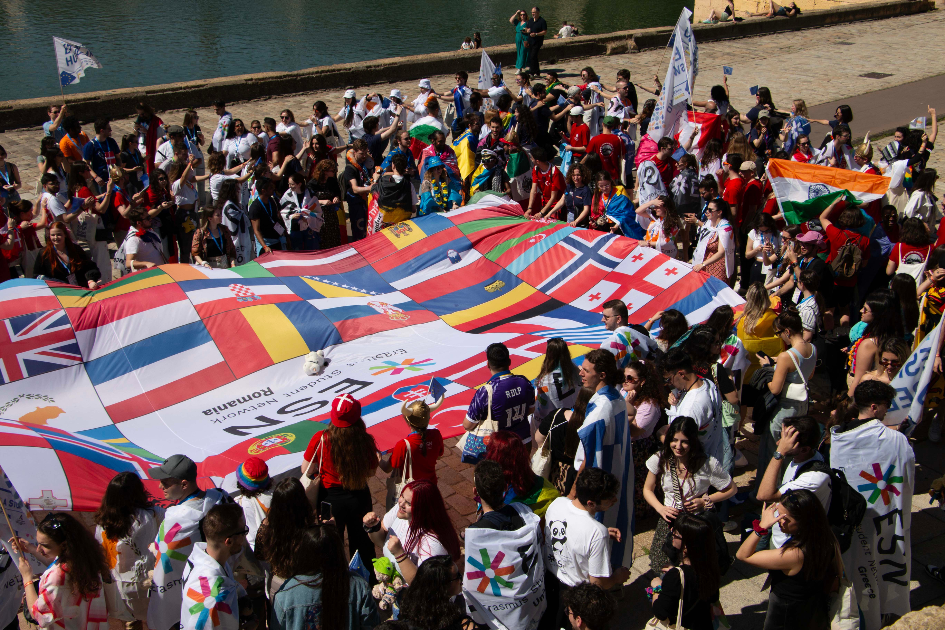


Erasmus Student Network
one of the largest student organisations in Europe, with over 530 local sections across 42 countries
we support both exchange and local students, ensuring everyone feels welcome
our goal is to promote mobility at the local, national, and international levels
STUDENTS HELPING STUDENTS
Notes:
ESN connects international students with their host communities through numerous initiatives, most notably through the Buddy System, SocialErasmus and Erasmus in Schools.
‹#›

Slide 3
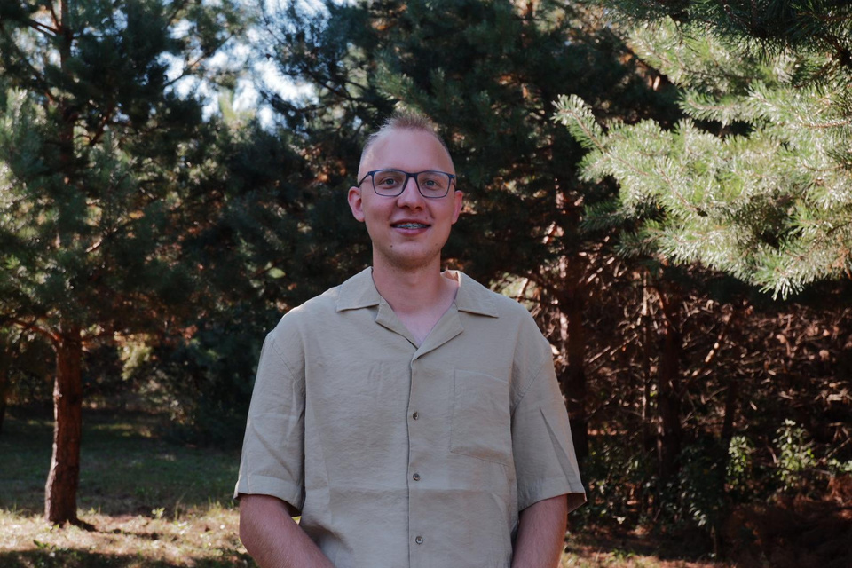
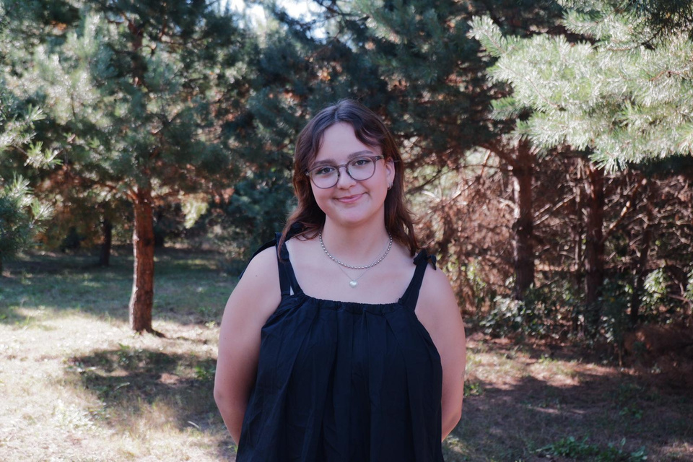
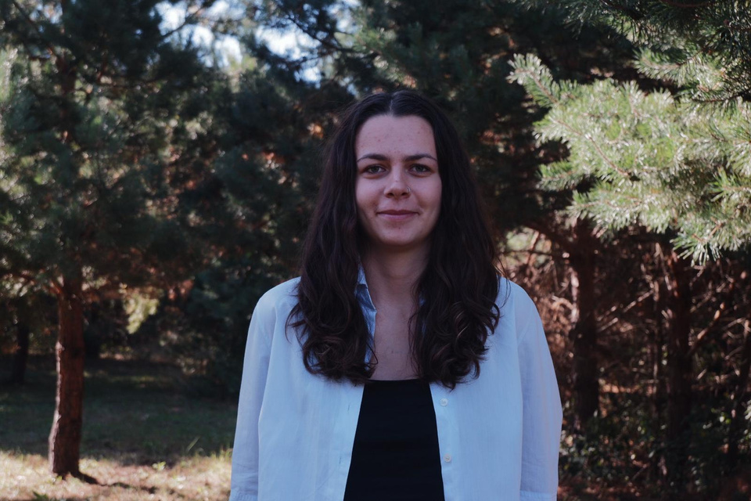
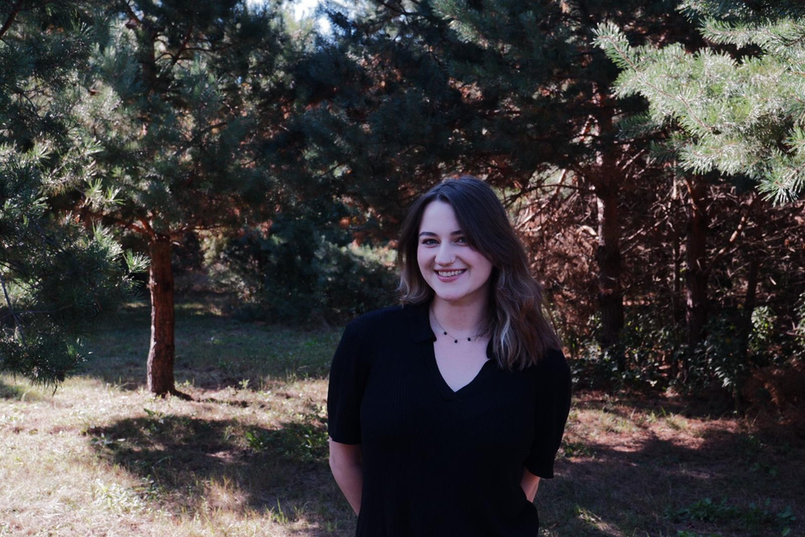
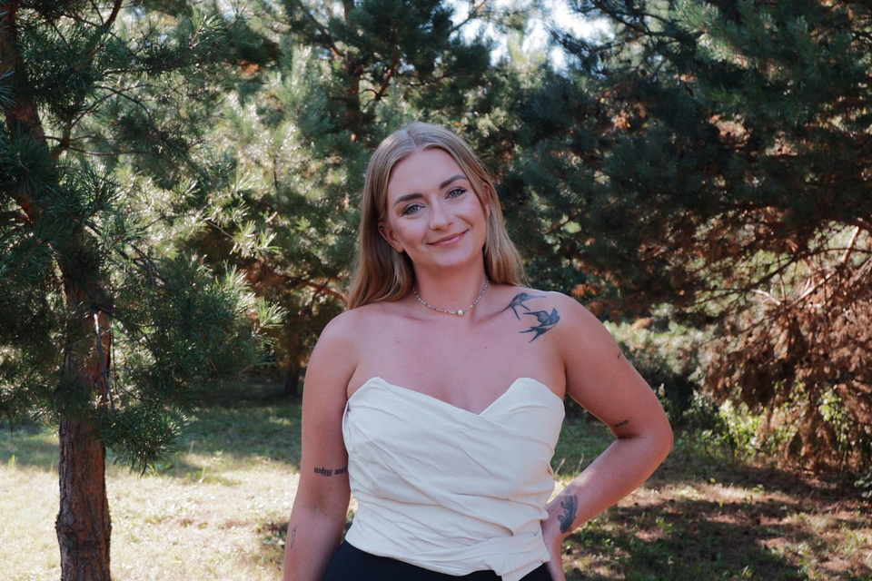
Our Board
President
Project Manager
Treasurer
Communication Manager
HR Manager
Radek Pławecki
Ola Kaniewska
Jagoda Błaż
Maja Łubczonek
Anna Lejczak
Notes:
ESN connects international students with their host communities through numerous initiatives, most notably through the Buddy System, SocialErasmus and Erasmus in Schools.
‹#›

Slide 4
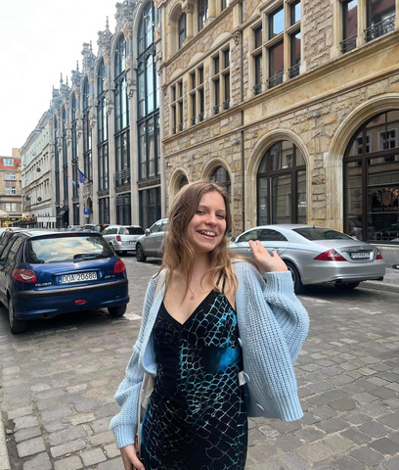
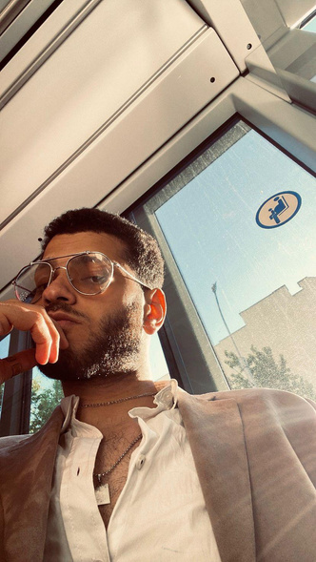
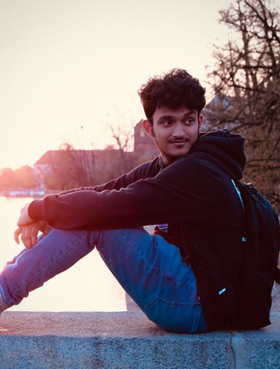
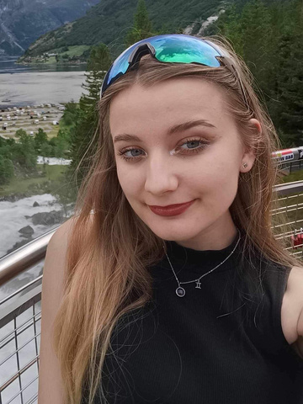
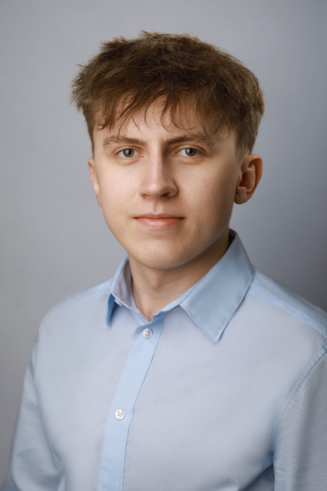

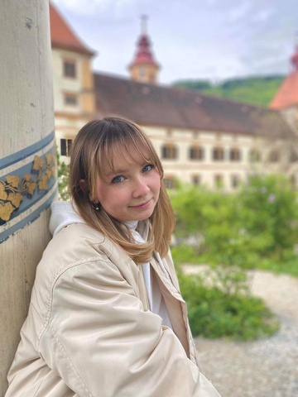
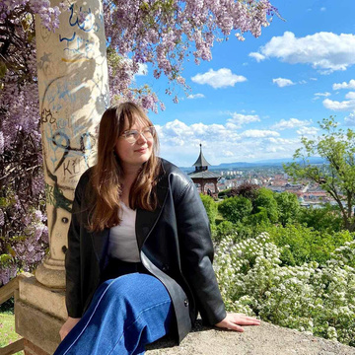
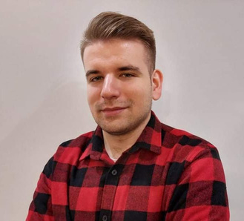
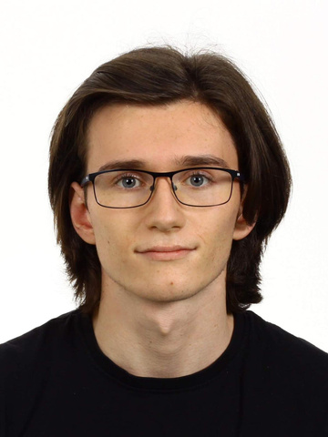
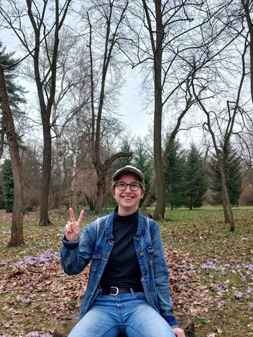
Our Coordinators
Culture
Social Impact
Sport
Party
ESN Thursdays
Mariia Didenko
Aly El-Boraei
Mohamed Fyrose
Natalia Skowrońska
Mateusz Dyla
Local Erasmus Games
Orientation Week
Buddy Programme
Travel
ESNcard
Szymon Misztal
Maria Kaczmarek
Aleksandra Żuchowska
Marek Hajduk
Anna Lejczak
Maja Łubczonek
Notes:
ESN connects international students with their host communities through numerous initiatives, most notably through the Buddy System, SocialErasmus and Erasmus in Schools.
‹#›

Slide 5
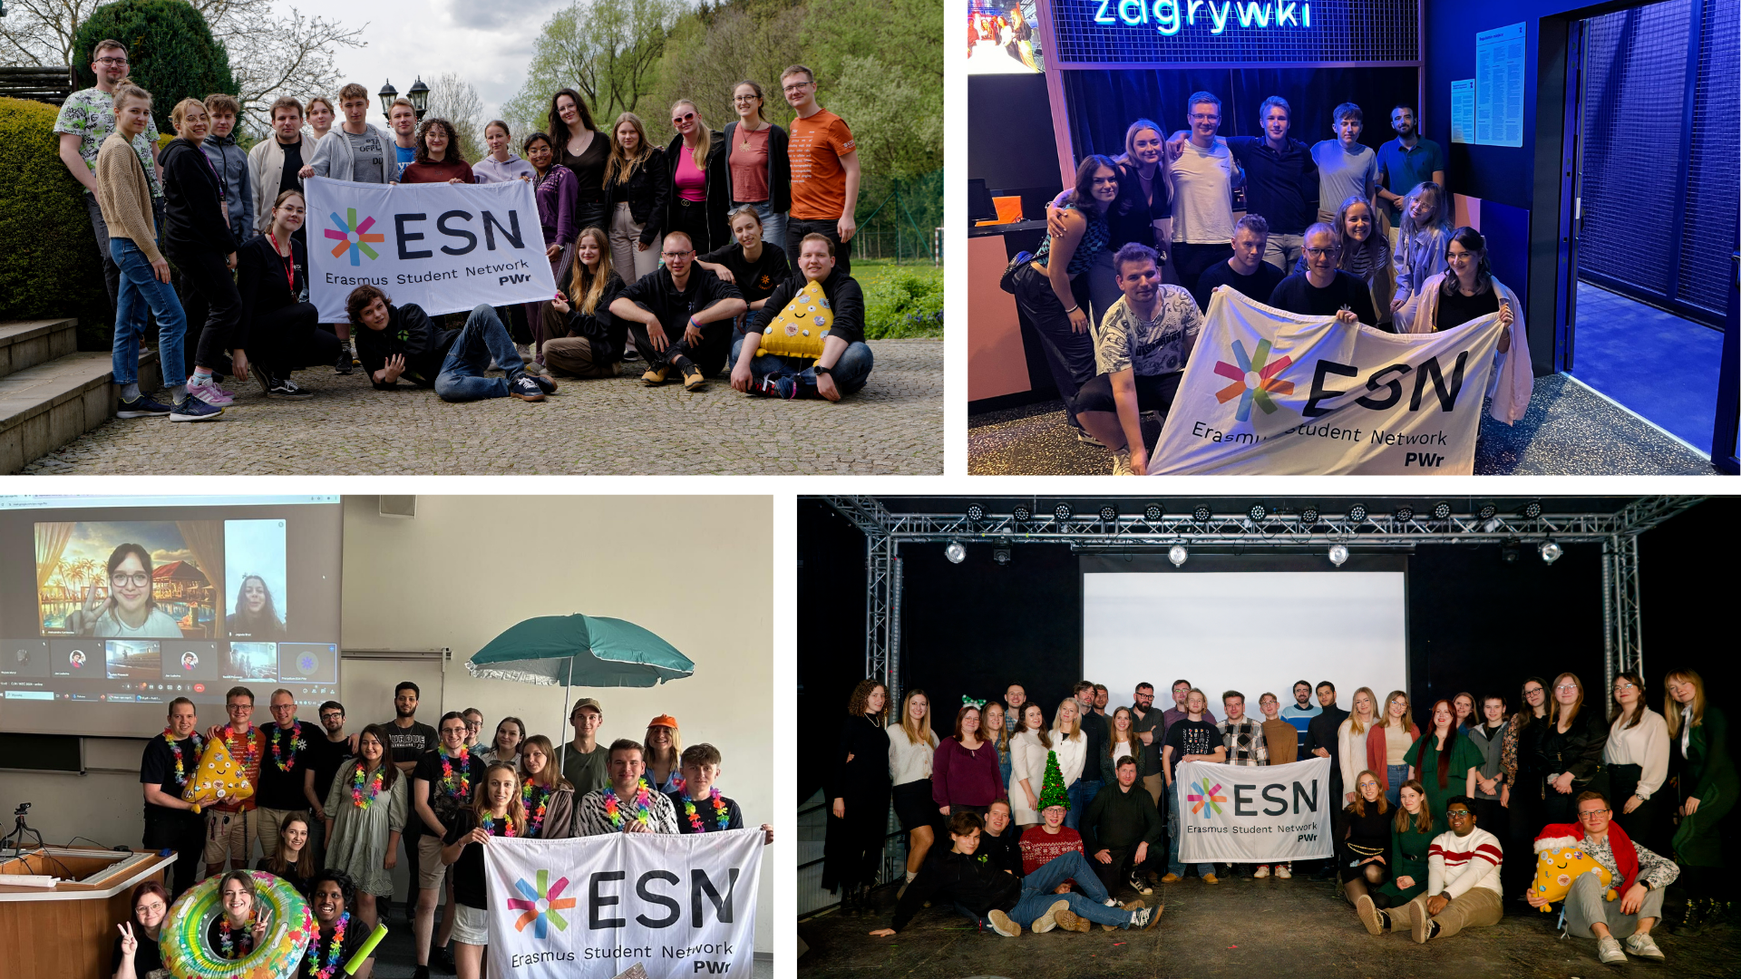
That’s us!
Notes:
ESN connects international students with their host communities through numerous initiatives, most notably through the Buddy System, SocialErasmus and Erasmus in Schools.
‹#›

Slide 6
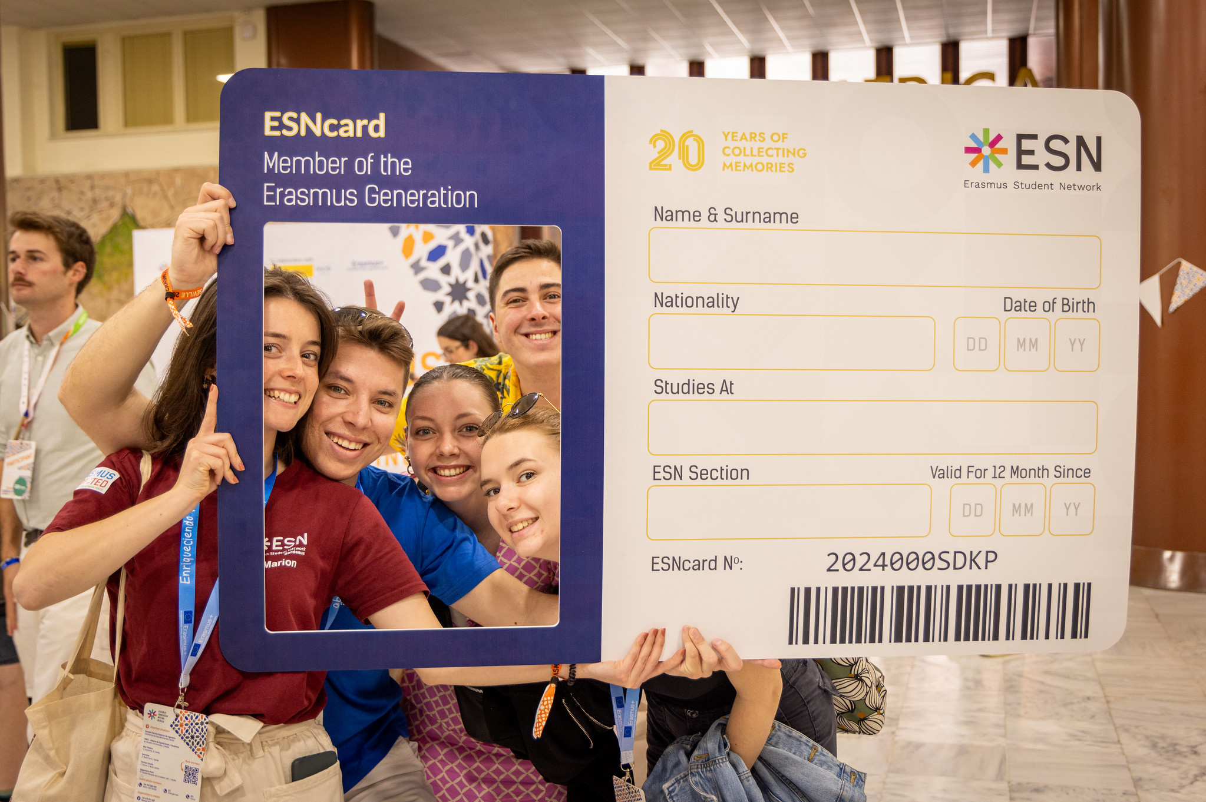
SERVICES
Notes:
ESN organises several events every year, where ESN volunteers from all over Europe meet to exchange ideas and best practices, and take decisions for the future of the organisation. This picture was taken during the Annual General Meeting in Thessaloniki, in April 2019.
‹#›

Slide 7
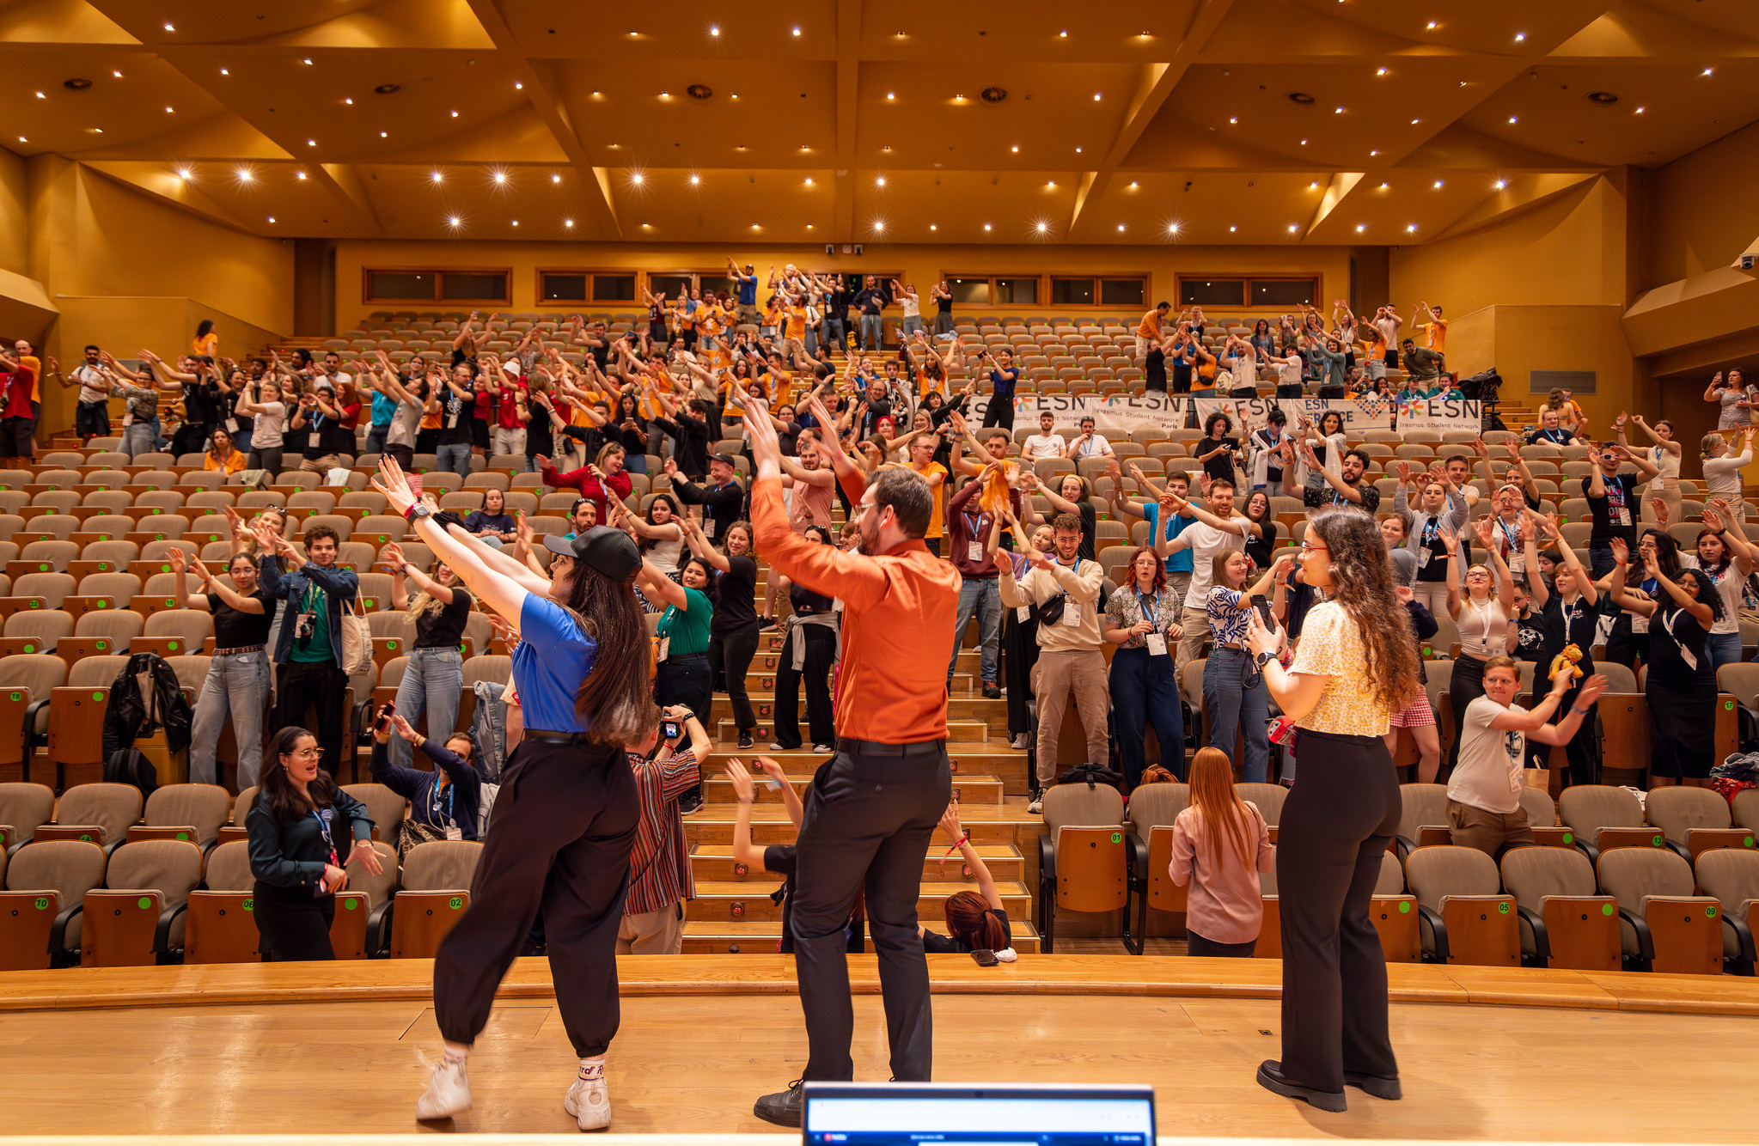

Buddy Programme
Notes:
ESN connects international students with their host communities through numerous initiatives, most notably through the Buddy System, SocialErasmus and Erasmus in Schools.
‹#›

Slide 8
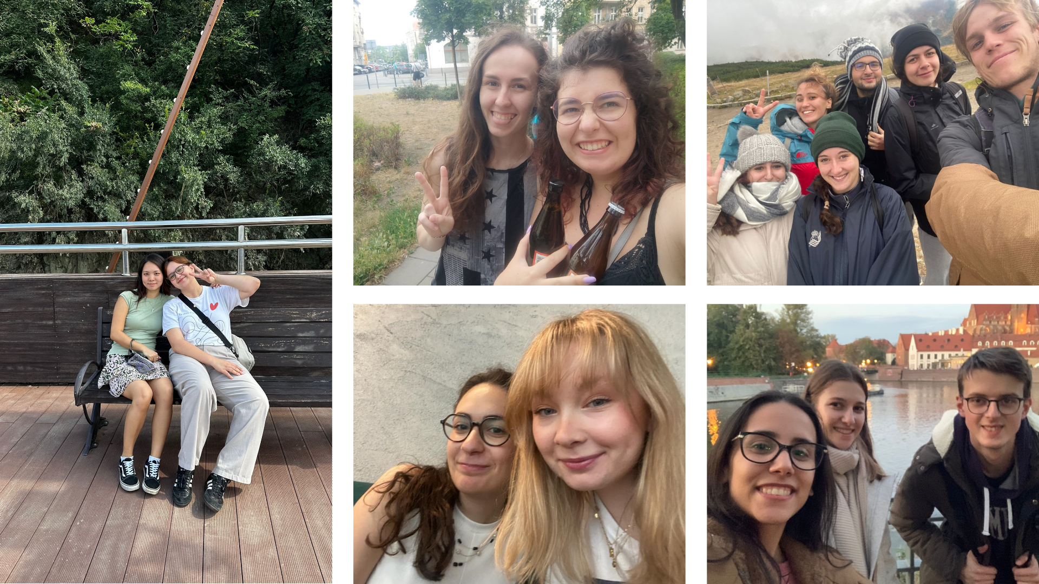
Buddy Programme
Notes:
ESN connects international students with their host communities through numerous initiatives, most notably through the Buddy System, SocialErasmus and Erasmus in Schools.
‹#›

Slide 9

Accommodation
the official accommodation partner for Erasmus students in Poland
they offer verified offers from professional landlords, with fully secured payment
use the code "ESNPWR" to get a 10% discount on the booking fee for your first reservation
Notes:
ESN connects international students with their host communities through numerous initiatives, most notably through the Buddy System, SocialErasmus and Erasmus in Schools.
‹#›

Slide 10

ESNcard
ESNcard is the membership card of the Erasmus Student Network. It gives you the access to services provided by our partners.
Notes:
ESN connects international students with their host communities through numerous initiatives, most notably through the Buddy System, SocialErasmus and Erasmus in Schools.
‹#›

Slide 11



ESNcard - international partners
Notes:
ESN connects international students with their host communities through numerous initiatives, most notably through the Buddy System, SocialErasmus and Erasmus in Schools.
‹#›

Slide 12




ESNcard - local partners (Wroclaw)
To know more, check out: https://esncard.org/
Notes:
ESN connects international students with their host communities through numerous initiatives, most notably through the Buddy System, SocialErasmus and Erasmus in Schools.
‹#›

Slide 13
How to get your ESNcard?
register on the card.esn.pl website*
can pick it up at our office during Office Hours once it has been delivered
take advantage of these incredible discounts and offers!
*Note: ESNcard is for all international students, both full-time and Erasmus students.
Notes:
ESN connects international students with their host communities through numerous initiatives, most notably through the Buddy System, SocialErasmus and Erasmus in Schools.
‹#›

Slide 14
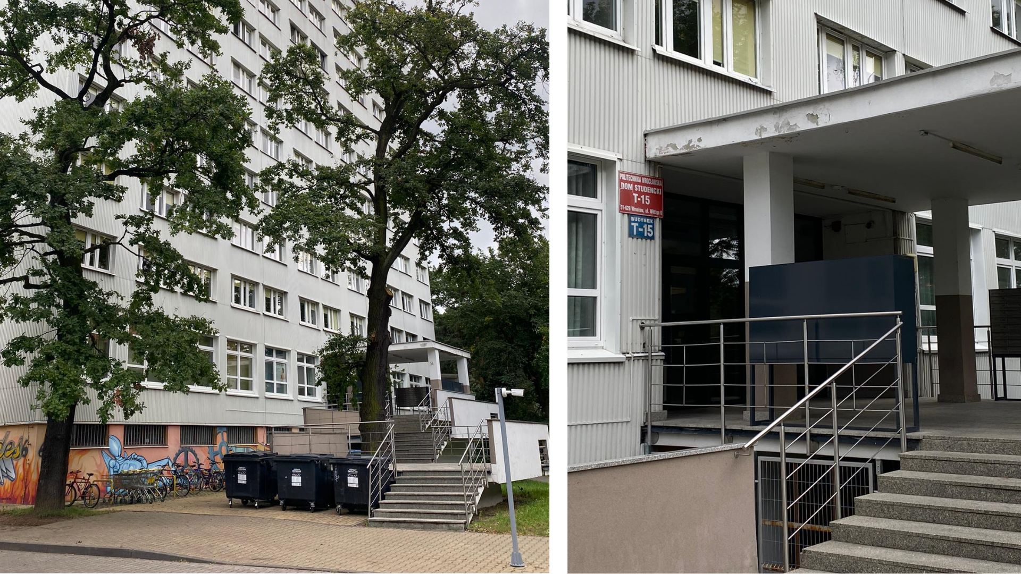
Our office
Dom Studencki (dormitory) T-15 "Hades"
Edwarda Wittiga 6, 51-628 Wrocław
Notes:
ESN connects international students with their host communities through numerous initiatives, most notably through the Buddy System, SocialErasmus and Erasmus in Schools.
‹#›

Slide 15
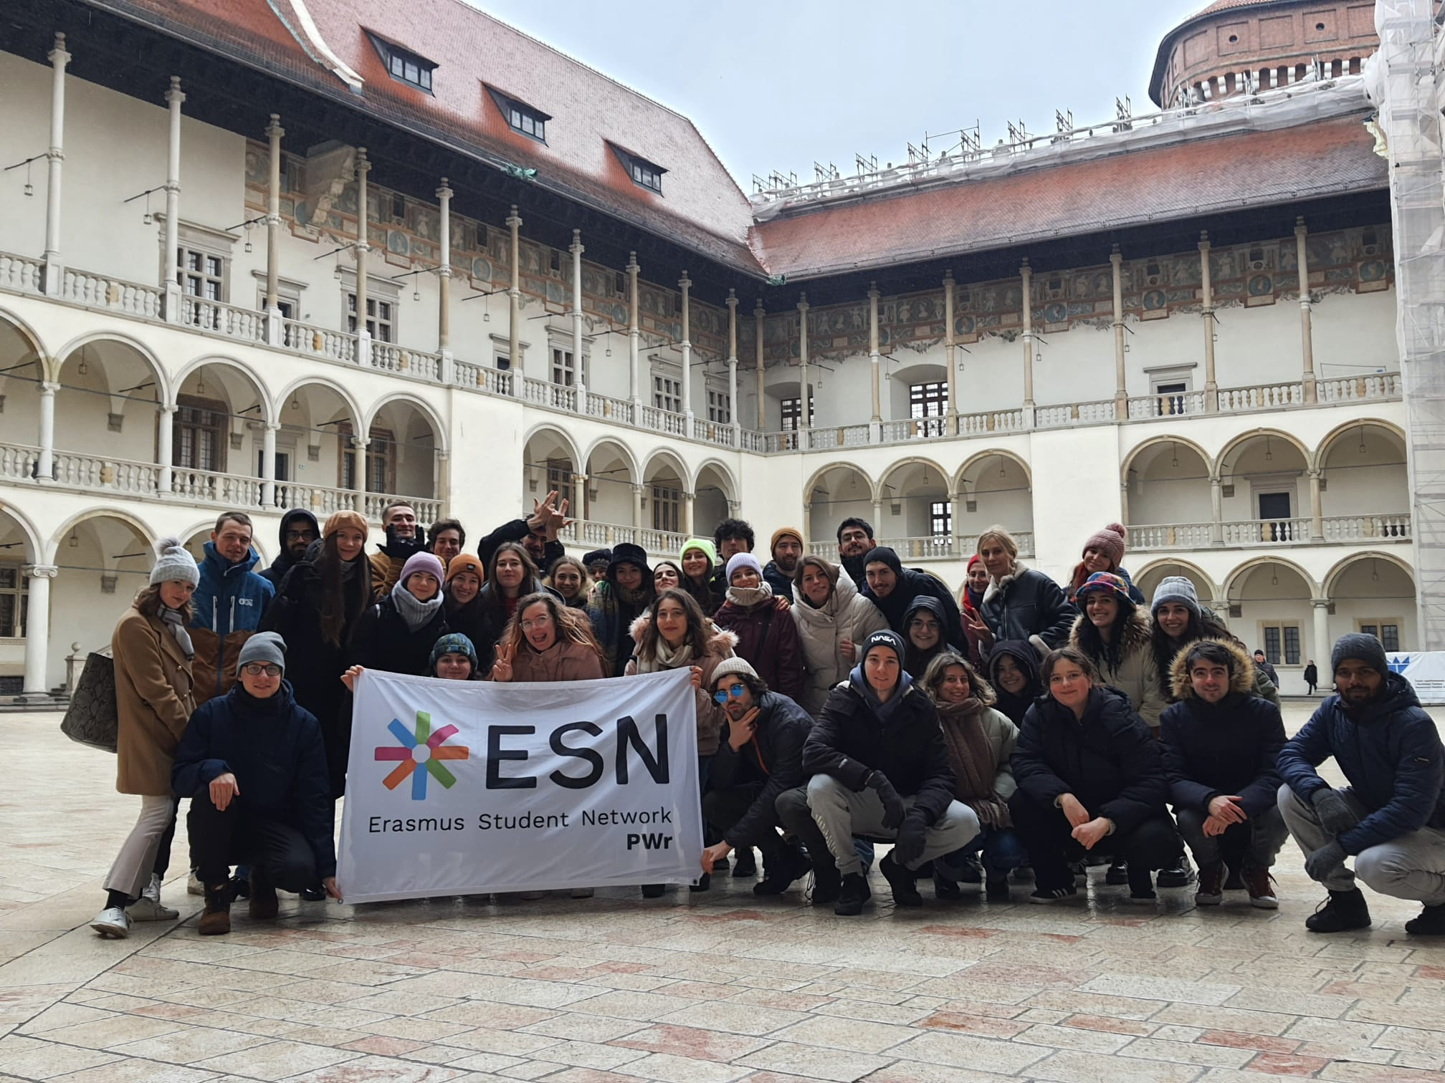
EVENTS
Notes:
ESN organises several events every year, where ESN volunteers from all over Europe meet to exchange ideas and best practices, and take decisions for the future of the organisation. This picture was taken during the Annual General Meeting in Thessaloniki, in April 2019.
‹#›

Slide 16
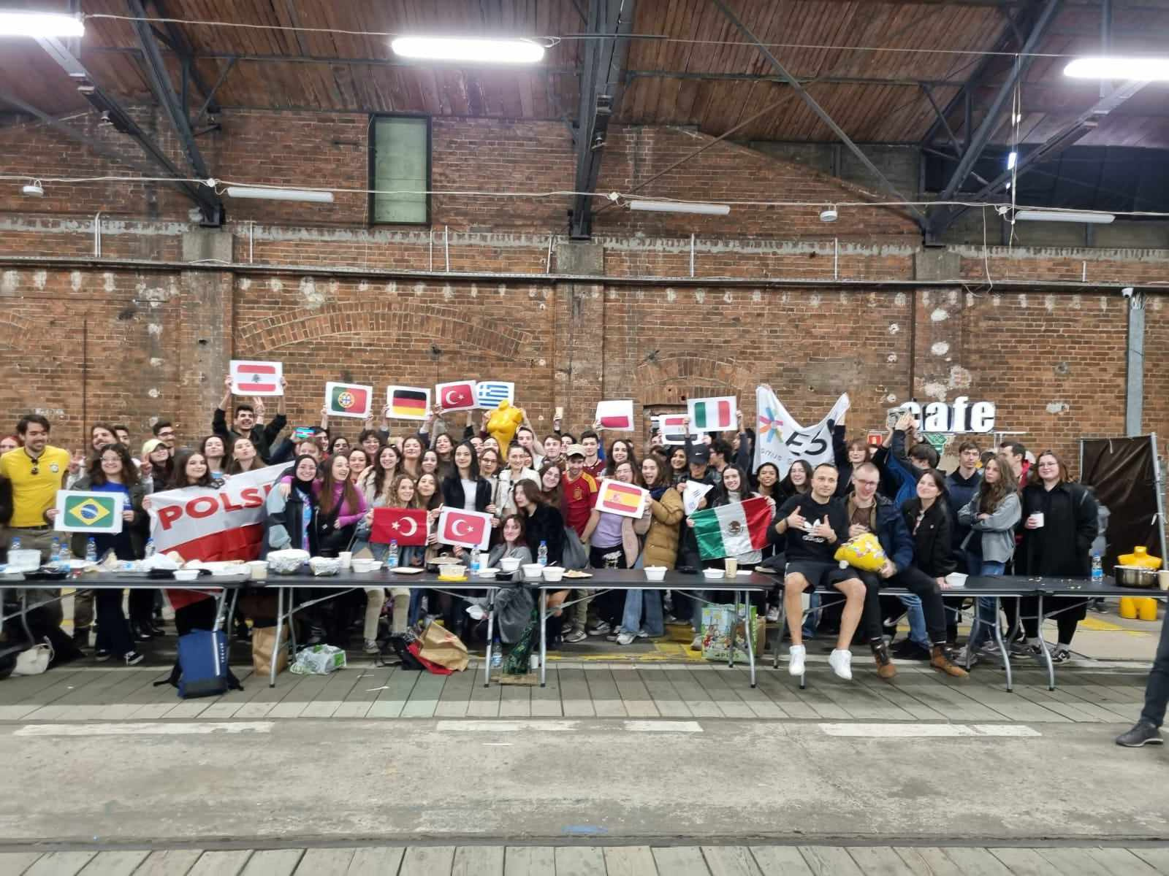

Orientation Week
Notes:
ESN organises several events every year, where ESN volunteers from all over Europe meet to exchange ideas and best practices, and take decisions for the future of the organisation. This picture was taken during the Annual General Meeting in Thessaloniki, in April 2019.
‹#›

Slide 17
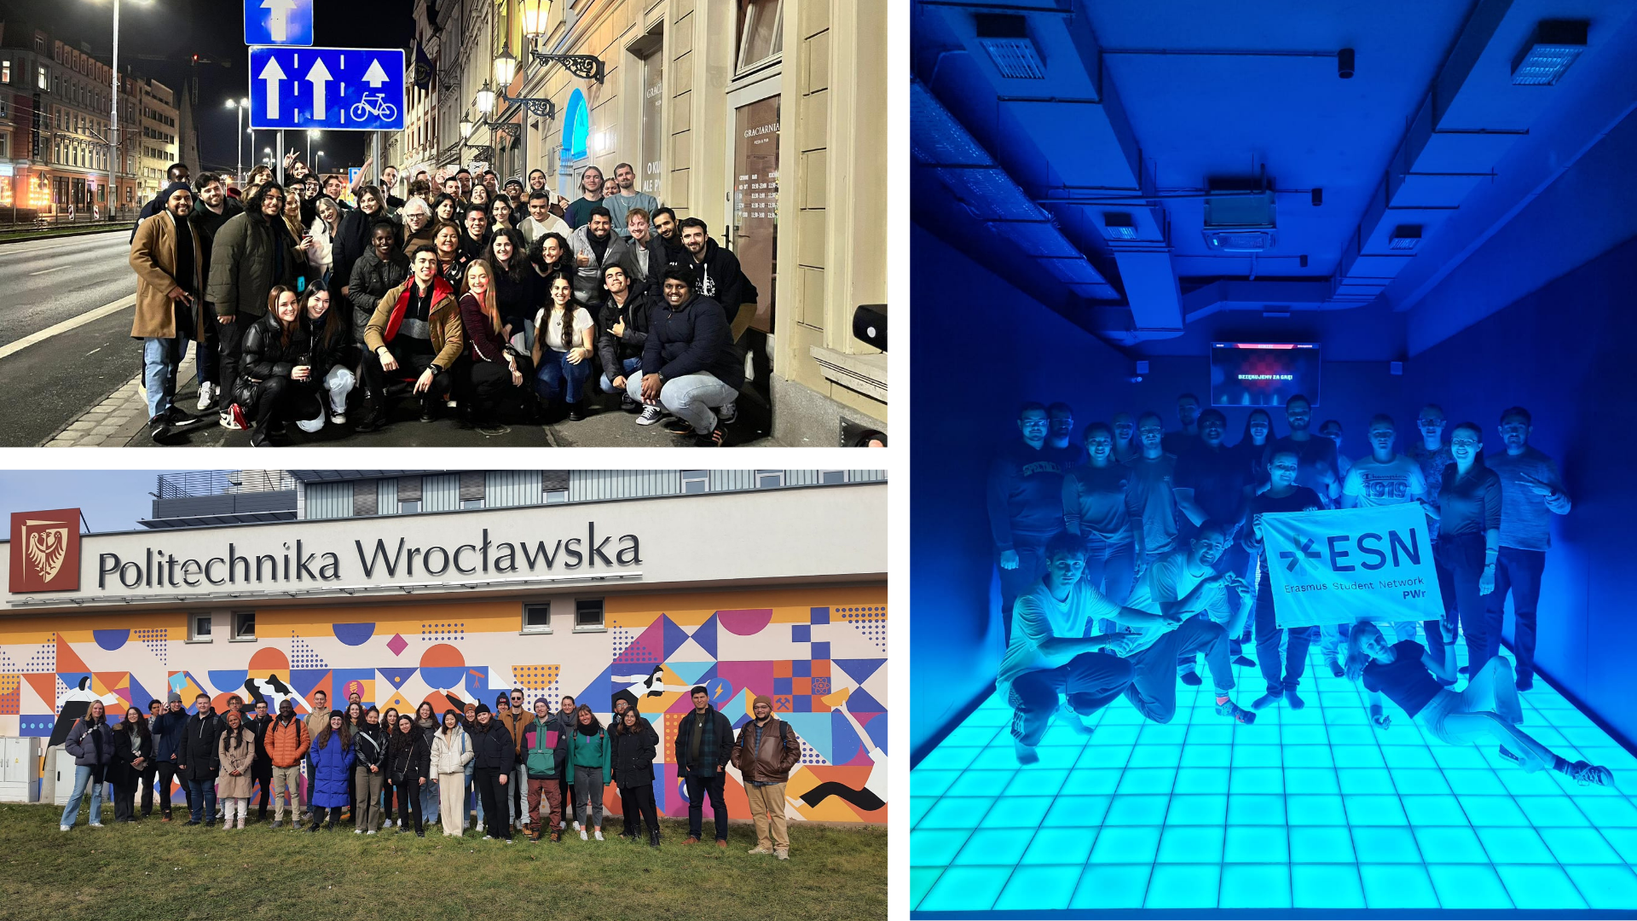
Orientation Week
Notes:
ESN organises several events every year, where ESN volunteers from all over Europe meet to exchange ideas and best practices, and take decisions for the future of the organisation. This picture was taken during the Annual General Meeting in Thessaloniki, in April 2019.
‹#›

Slide 18
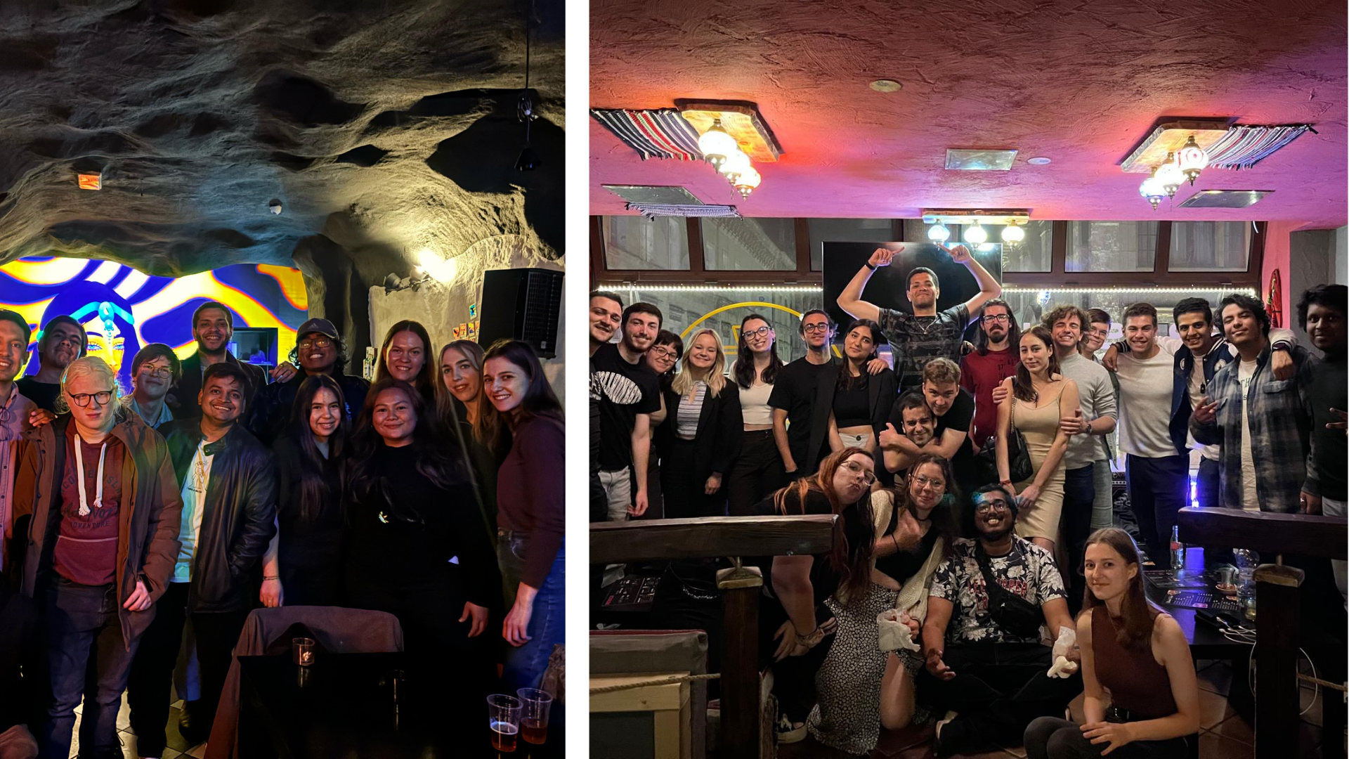
ESN Thursdays
Notes:
ESN organises several events every year, where ESN volunteers from all over Europe meet to exchange ideas and best practices, and take decisions for the future of the organisation. This picture was taken during the Annual General Meeting in Thessaloniki, in April 2019.
‹#›

Slide 19
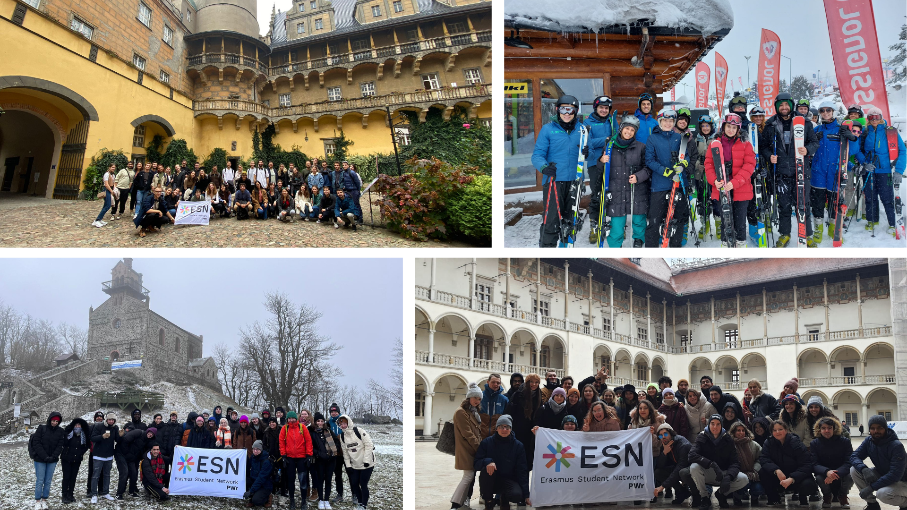
Trips
Notes:
ESN organises several events every year, where ESN volunteers from all over Europe meet to exchange ideas and best practices, and take decisions for the future of the organisation. This picture was taken during the Annual General Meeting in Thessaloniki, in April 2019.
‹#›

Slide 20
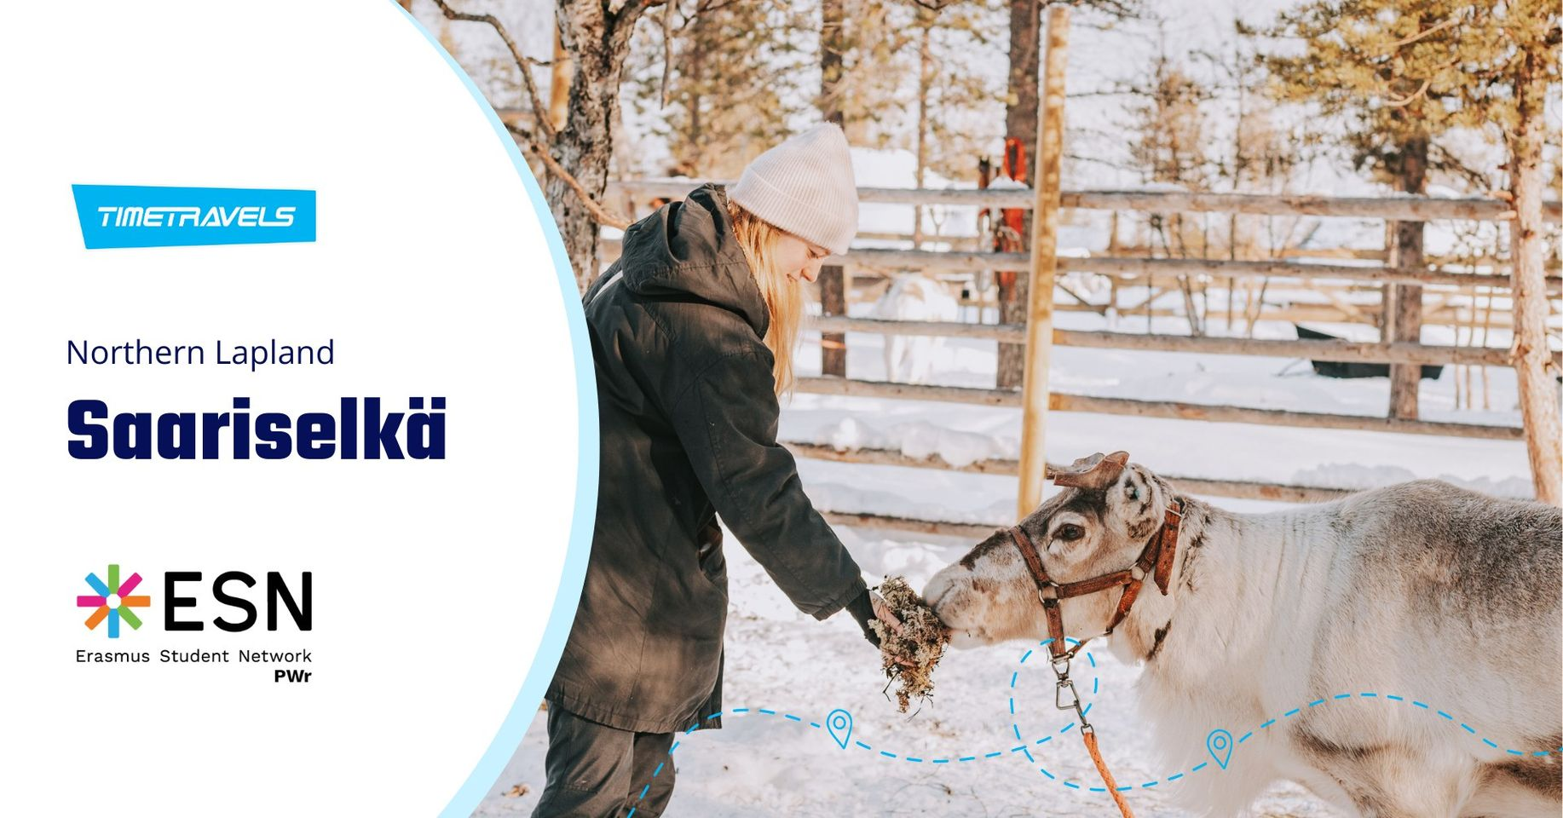
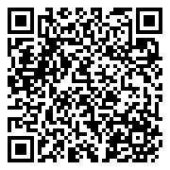
Timetravels
Adventure to Northern Lapland, Saariselkä
12 - 20 December #SaveTheDate
Notes:
ESN organises several events every year, where ESN volunteers from all over Europe meet to exchange ideas and best practices, and take decisions for the future of the organisation. This picture was taken during the Annual General Meeting in Thessaloniki, in April 2019.
‹#›

Slide 21
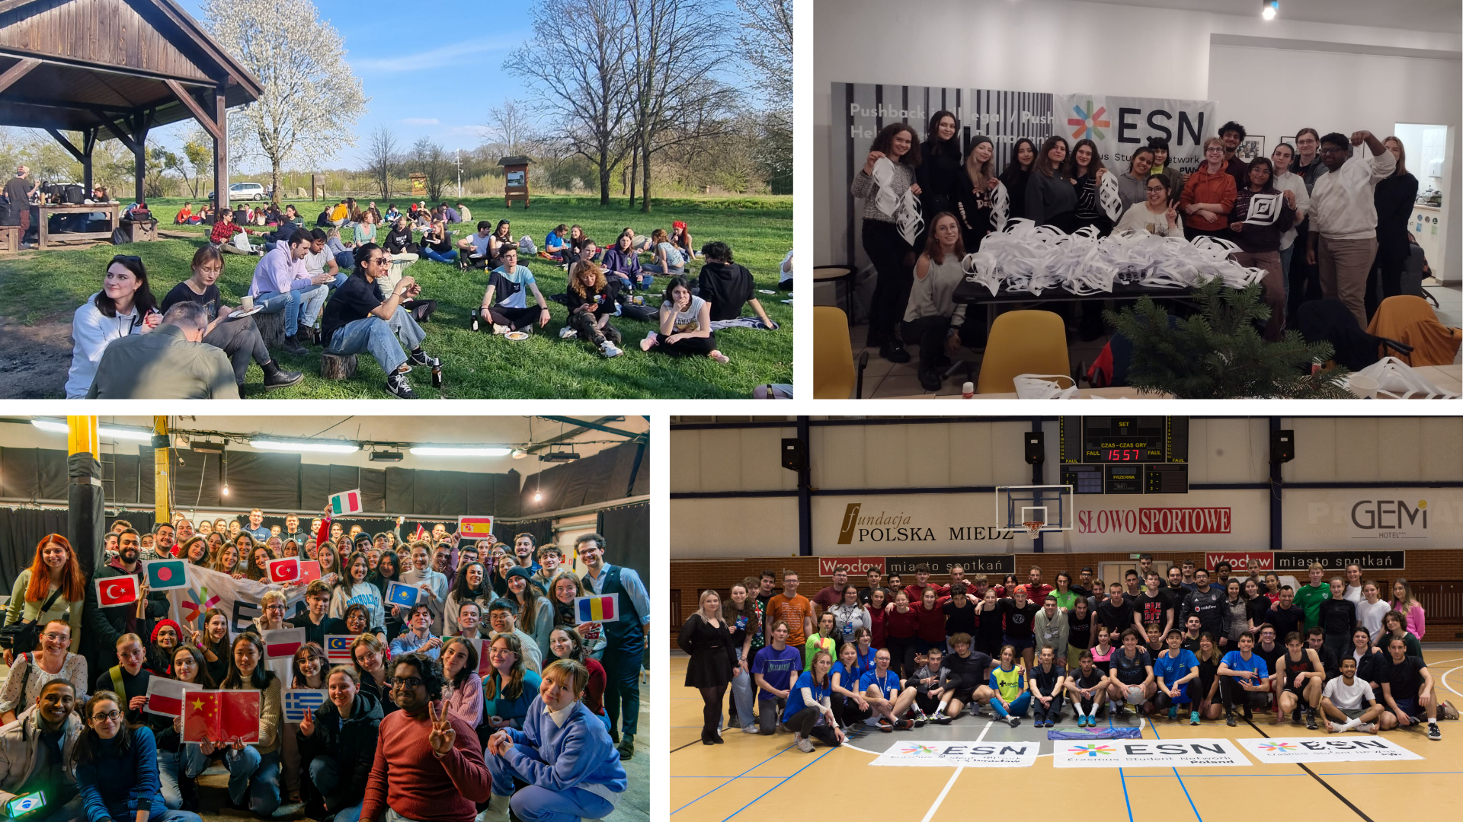
Is that everything?
Notes:
ESN organises several events every year, where ESN volunteers from all over Europe meet to exchange ideas and best practices, and take decisions for the future of the organisation. This picture was taken during the Annual General Meeting in Thessaloniki, in April 2019.
‹#›

Slide 22
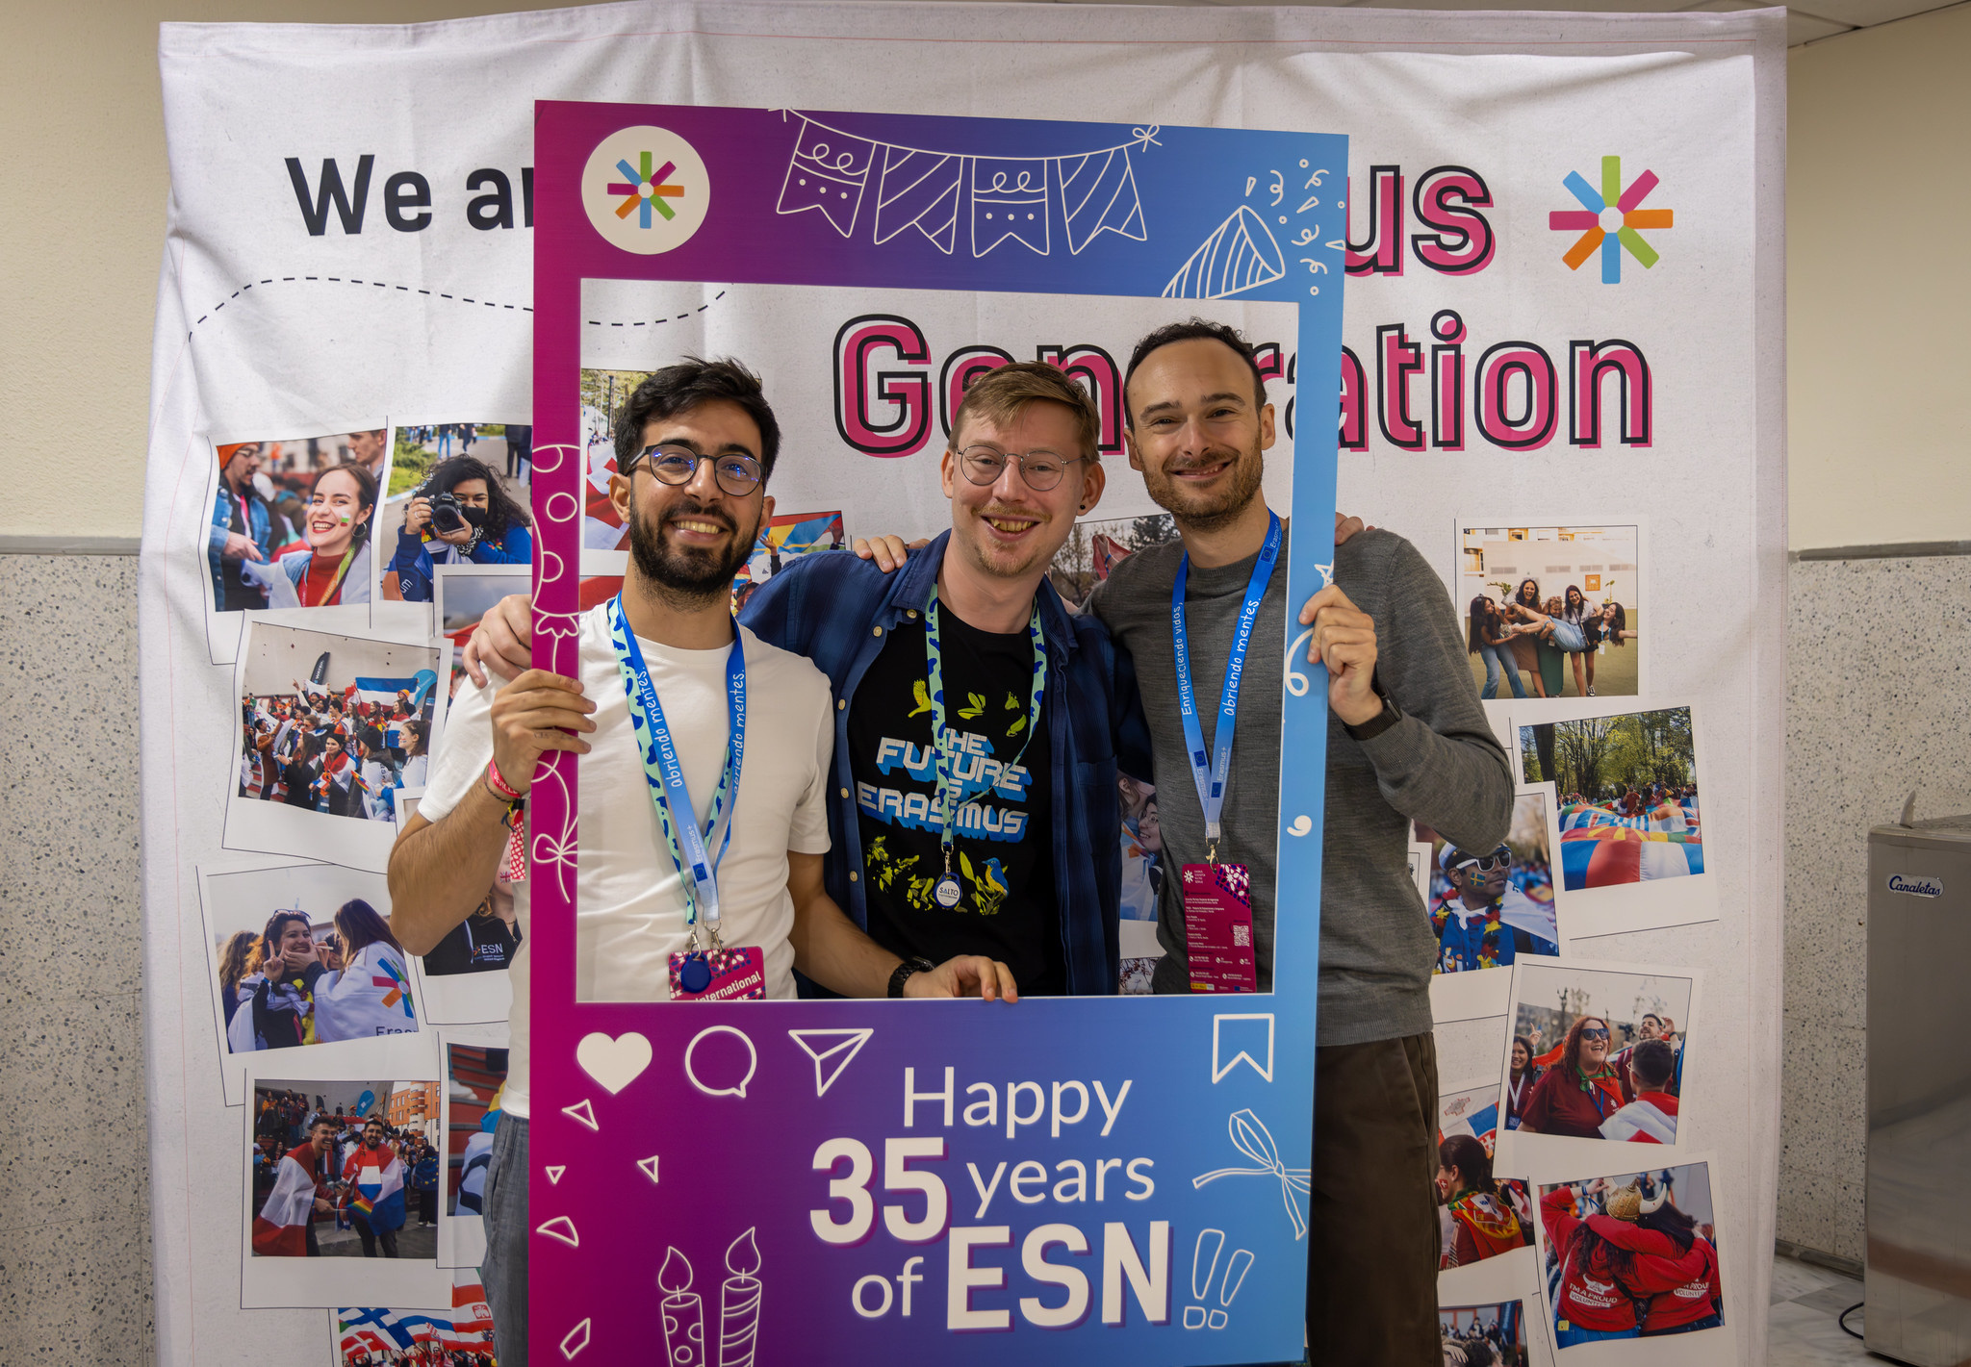
SOCIAL MEDIA
Notes:
ESN organises several events every year, where ESN volunteers from all over Europe meet to exchange ideas and best practices, and take decisions for the future of the organisation. This picture was taken during the Annual General Meeting in Thessaloniki, in April 2019.
‹#›

Slide 23
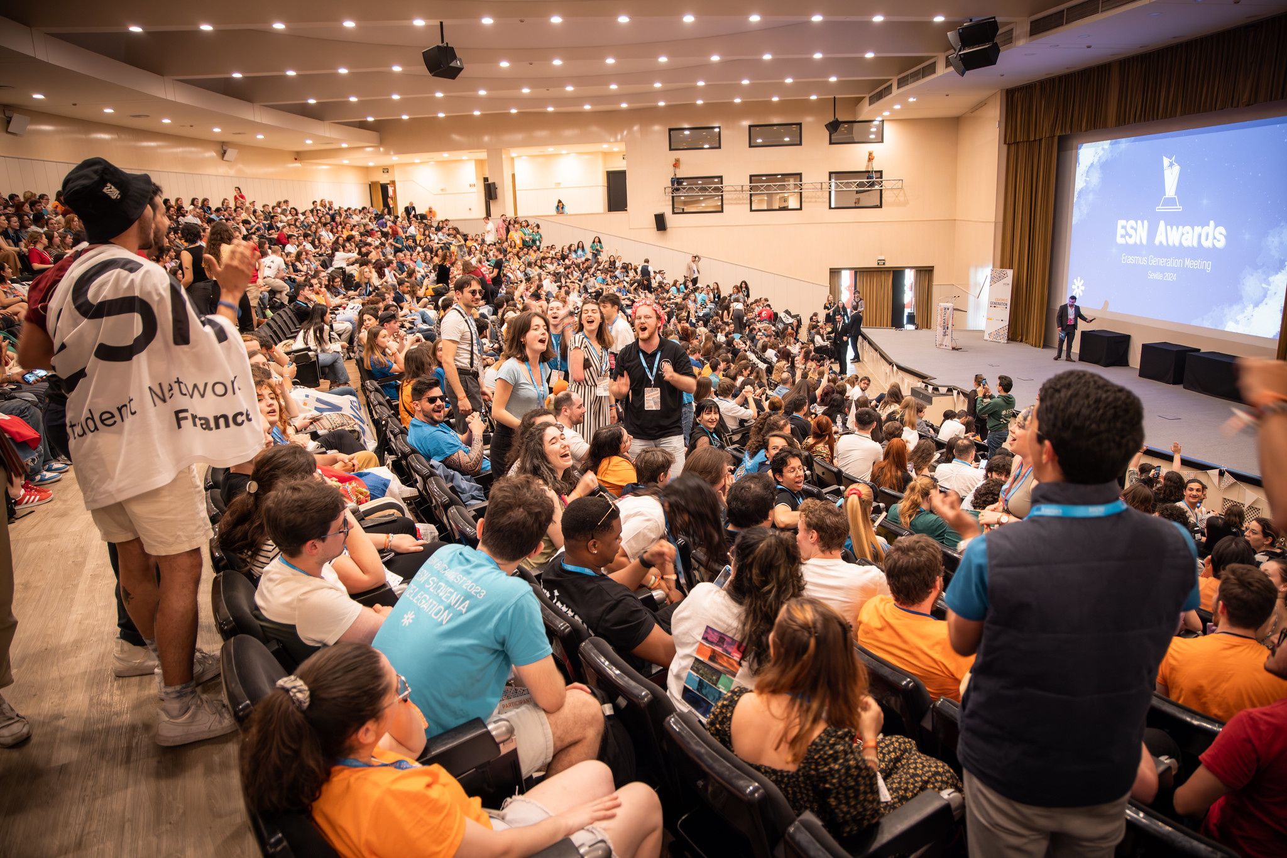
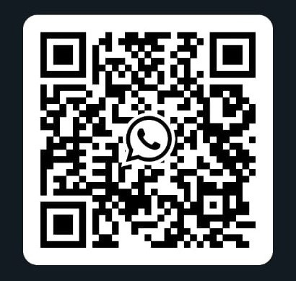
WhatsApp
Community
Erasmus Wroclaw 2024/2025
Notes:
ESN organises several events every year, where ESN volunteers from all over Europe meet to exchange ideas and best practices, and take decisions for the future of the organisation. This picture was taken during the Annual General Meeting in Thessaloniki, in April 2019.
‹#›

Slide 24
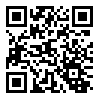
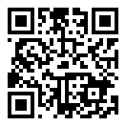
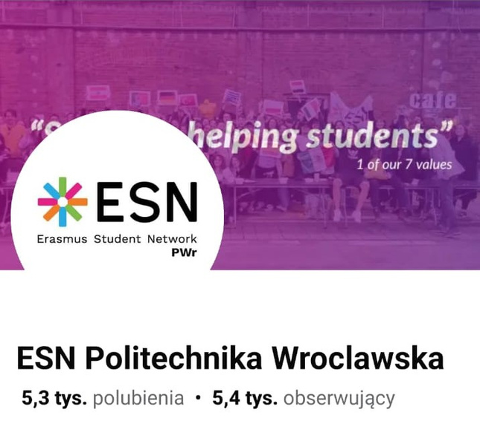
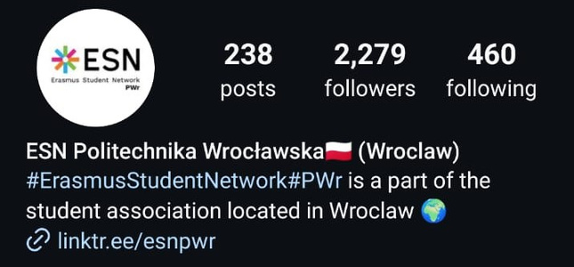
Social media
Facebook
Instagram
ESN Politechnika Wroclawska
@esnpwr
Notes:
ESN organises several events every year, where ESN volunteers from all over Europe meet to exchange ideas and best practices, and take decisions for the future of the organisation. This picture was taken during the Annual General Meeting in Thessaloniki, in April 2019.
‹#›

Slide 25

Feel free to reach out to us anytime!
Radek Pławecki
President
president.pwr@esn.pl
Anna Lejczak
Communication Manager
pr.pwr@esn.pl
Jagoda Błaż
Treasurer
treasurer.pwr@esn.pl
Ola Kaniewska
Project Manager
pm.pwr@esn.pl
Maja Łubczonek
HR Manager
hr.pwr@esn.pl
We are the Erasmus Generation!
Notes:
ESN connects international students with their host communities through numerous initiatives, most notably through the Buddy System, SocialErasmus and Erasmus in Schools.
‹#›

